Slide 1
Please grab a pencil and paper to write your answers.

Slide 2

Please mute your microphone

Slide 3
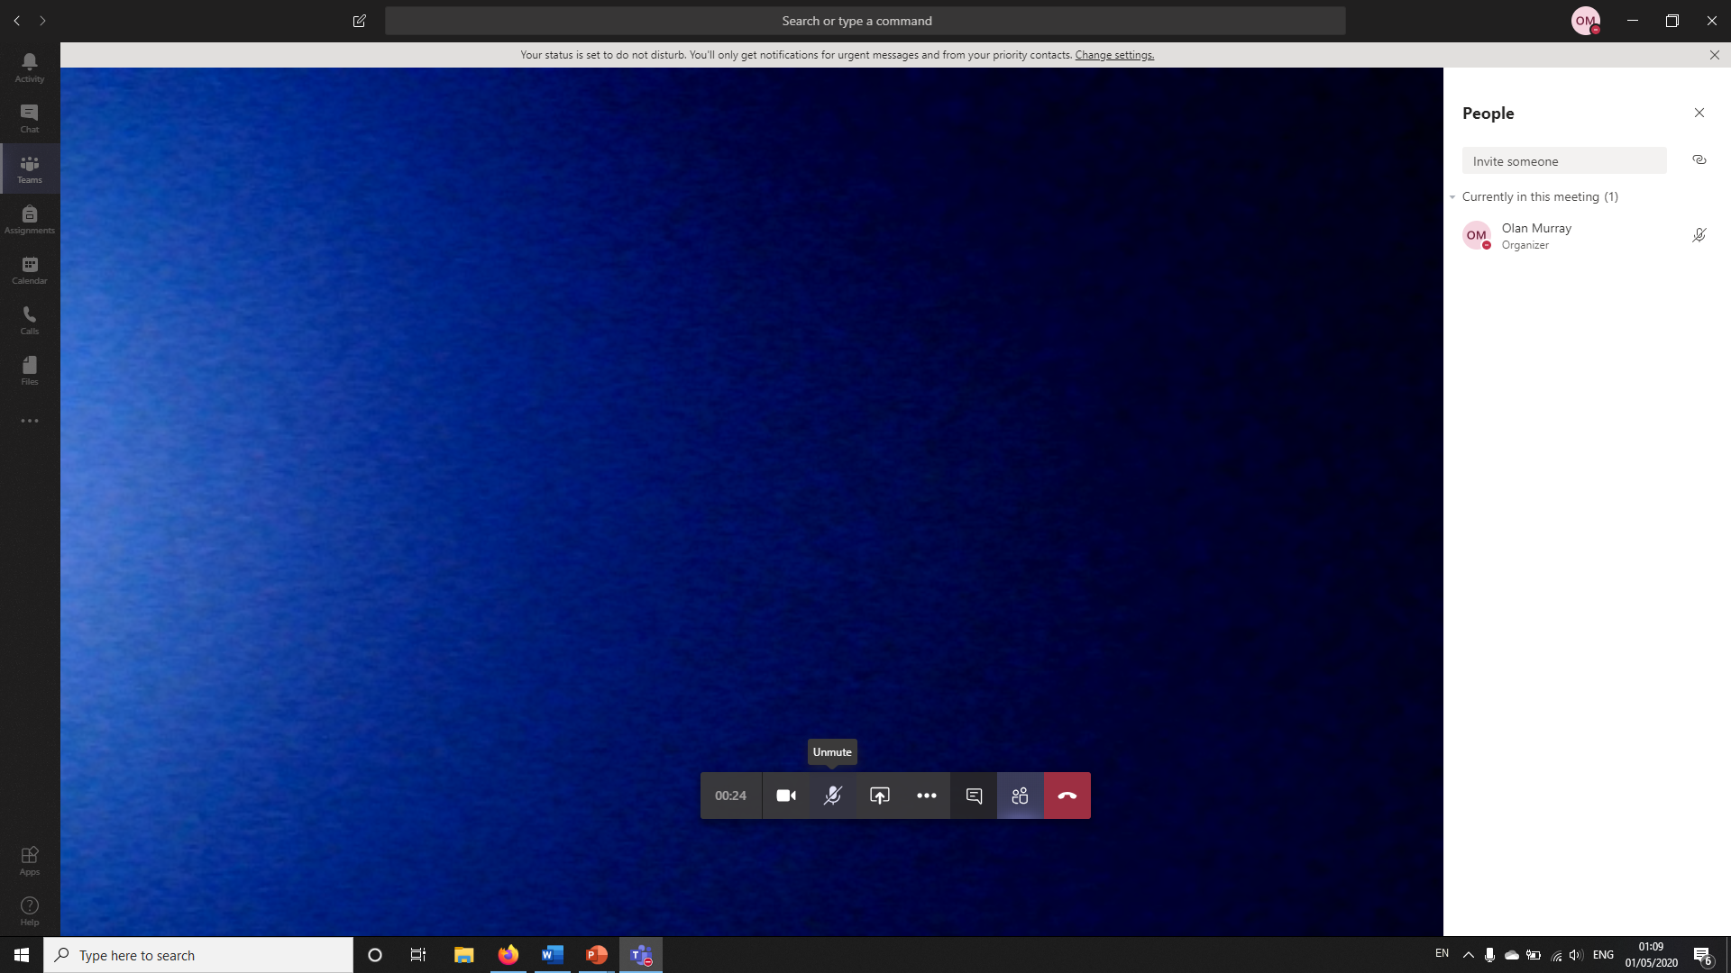
Move your mouse or tap the screen.
You should see your microphone crossed out if it is on mute

Slide 4
Please mute your microphone
Remember not to call out your answers!

Slide 5
Round One

Slide 6
1. What two colours are on the Greek flag?

Slide 7
2. Limerick is built on which river?

Slide 8
3. What is the name of the boy who lives next door to Andy in Toy story one?

Slide 9
4. Who wrote George’s Marvellous Medecine , Boy and James and the Giant Peach?

Slide 10
5. In what country would you find the Mona Lisa hanging?

Slide 11
6. At the bottom of the 5th and 6th class stairs there is a quote on the wall that says ‘Every child is ____ ____’?

Slide 12
7. Complete the phrase: A bird in the hand is worth two in the _______?

Slide 13
8. What do you get when you multiply the length of a rectangle by its width?

Slide 14
Round Two

Slide 15
9. What year was the main school built in? (Hint, it’s written over the door)

Slide 16
10. Name the four main cardinal points.

Slide 17
11. What instrument has four strings, is from Hawaii and looks like a small guitar?

Slide 18
12. What is Garfield the cat’s favourite food?

Slide 19
13. When did the Olympics take place in London? 2012, 2014 or 2016?

Slide 20
14. Who is the Prime Minister of Britain?

Slide 21
15. What were piano keys originally made from?

Slide 22
16. What boat sank off the Old Head of Kinsale when it was hit by a torpedo from a German U-boat in 1915?

Slide 23
Round One
Answers

Slide 24
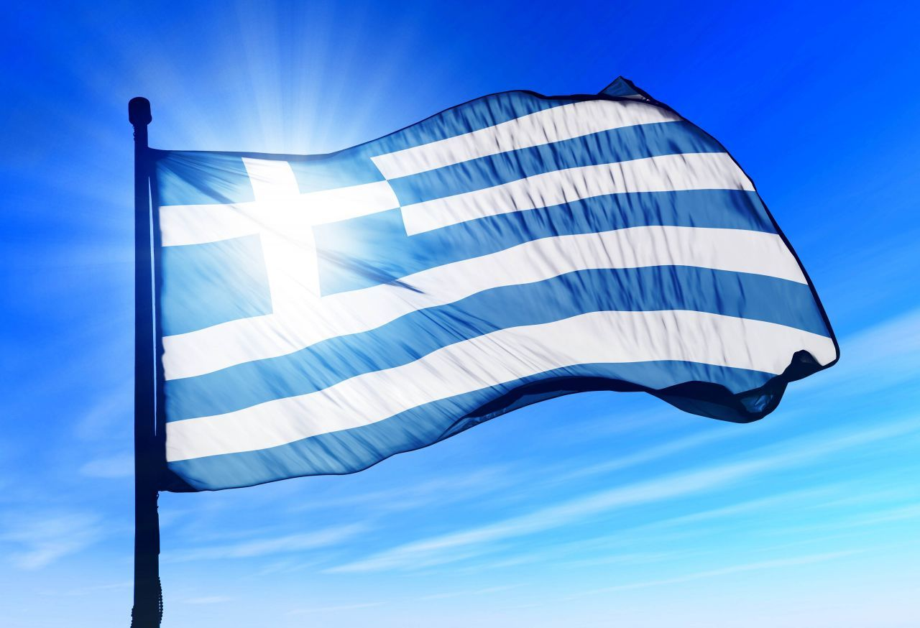
What two colours are on the Greek flag? Blue and white.

Slide 25
2. Limerick is built on which river? Shannon

Slide 26
3. What is the name of the boy who lives next door to Andy in Toy story one? Sid

Slide 27
4. Who wrote George’s Marvellous Medecine , Boy and James and the Giant Peach? Roald Dahl

Slide 28
5. In what country would you find the Mona Lisa hanging? France, Paris, Louvre

Slide 29
6. At the bottom of the 5th and 6th class stairs there is a quote on the wall that says ‘Every child is ____ ____’? an artist. Picasso

Slide 30
7. Complete the phrase: A bird in the hand is worth two in the _______? Bush

Slide 31
8. What do you get when you multiply the length of a rectangle by its width? The area.

Slide 32
Round Three

Slide 33
17. On what day of the week did the government close the schools due to Covid-19?

Slide 34
Name three longest rivers in Cork.

Slide 35
19. If bovine is a word to describe cows, what animal does the word equine describe?

Slide 36
20. What is the most popular song in the world?

Slide 37
21. ‘Les pommes frites’ is the French name for what food?

Slide 38
22. Who is the Taoiseach?

Slide 39
23. What two first names make up the name of a famous ice-cream brand?

Slide 40
24. What age would you be if you were 96 months old?

Slide 41
Round Two
Answers

Slide 42
9. What year was the main school built in? (Hint, it’s written over the door) 1972

Slide 43
10. Name the four main cardinal points. North, South, East and West.

Slide 44
11. What instrument has four strings, is from Hawaii and looks like a small guitar? Ukulele

Slide 45
12. What is Garfield the cat’s favourite food? Lasagne

Slide 46
13. When did the Olympics take place in London? 2012, 2014 or 2016? 2012

Slide 47
14. Who is the Prime Minister of Britain? Boris Johnson

Slide 48
15. What were piano keys originally made from? Ivory.

Slide 49
16. What boat sank off the Old Head of Kinsale when it was hit by a torpedo from a German U-boat in 1915? Lusitania

Slide 50
Round Four

Slide 51
25. Can you name the only 3 countries in the world to begin with the letter F?

Slide 52
26. What colour jersey is given to the winner of a stage of the Tour de France?

Slide 53
27. What type of dog did Cruella De Vil try to steal in the film?

Slide 54
28. What date did Easter Sunday fall on this year?

Slide 55
29. Which two Premier League soccer teams play in Liverpool?

Slide 56
30. What country is Lionel Messi from?

Slide 57
31. Which car company is no longer allowed use the slogan ‘The Best Built Cars in the World’?

Slide 58
32. How many fingers including the thumbs does Homer Simpson have?

Slide 59
Round Three
Answers

Slide 60
17. On what day of the week did the government close the schools due to Covid-19? Thursday 12th of March

Slide 61
Name three longest rivers in Cork. The Blackwater, Lee and Bandon.

Slide 62
19. If bovine is a word to describe cows, what animal does the word equine describe? Horses

Slide 63
20. What is the most popular song in the world? Happy Birthday

Slide 64
21. ‘Les pommes frites’ is the French name for what food? Chips

Slide 65
22. Who is the Taoiseach? Leo Varadker

Slide 66
23. What two first names make up the name of a famous ice-cream brand? Ben and Jerry’s

Slide 67
24. What age would you be if you were 96 months old? 8years

Slide 68
Round Five

Slide 69
33. Why was the Notre Dame cathedral in the news this time last year?

Slide 70
34. Which billionaire owns the majority share in the Tesla car company?

Slide 71
35. In which county would you find the town of Kenmare?

Slide 72
36. What colour is the outside of the front door of the school painted?

Slide 73
37. What board game features reptiles and objects to scale heights?

Slide 74
38. What is the oldest city in Ireland?

Slide 75
39. How many classrooms are upstairs in TBNS?

Slide 76
40. We know that Neil Armstrong was the first man on the moon but who was the second man on the moon?

Slide 77
Round Four
Answers

Slide 78
25. Can you name the only 3 countries in the world to begin with the letter F? France, Fiji, Finland.

Slide 79
26. What colour jersey is given to the winner of a stage of the Tour de France? Yellow

Slide 80
27. What type of dog did Cruella De Vil try to steal in the film? Dalmatian

Slide 81
28. What date did Easter Sunday fall on this year? April 12th

Slide 82
29. Which two Premier League soccer teams play in Liverpool? Everton and Liverpool

Slide 83
30. What country is Lionel Messi from? Argentina

Slide 84
31. Which car company are no longer allowed to use the slogan ‘The Best Built Cars in the World’? Toyota

Slide 85
32. How many fingers including the thumbs does Homer Simpson have? 8

Slide 86
Round Five
Answers

Slide 87
33. Why was the Notre Dame cathedral in the news this time last year? Burned down

Slide 88
34. Which billionaire owns the majority share in the Tesla car company? Elon Musk

Slide 89
35. In which county would you find the town of Kenmare? Kerry

Slide 90
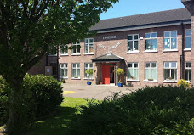
36. What colour is the outside of the front door of the school painted? Red

Slide 91
37. What board game features reptiles and objects to scale heights? Snakes and ladders

Slide 92
38. What is the oldest city in Ireland? Waterford

Slide 93
39. How many classrooms are upstairs in TBNS? 6

Slide 94
40. We know that Neil Armstrong was the first man on the moon but who was the second man on the moon? Buzz Aldrin.

Slide 95
Bonus Questions
Can you name the star from their sibling?

Slide 96
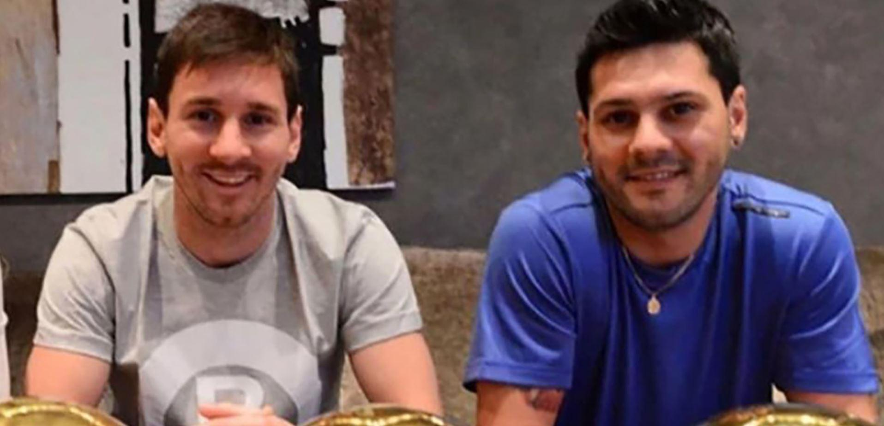

Slide 98
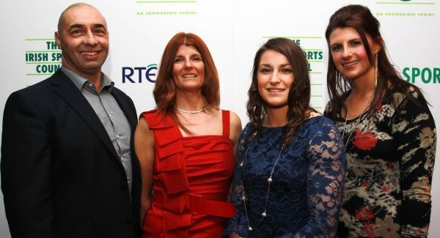


Slide 100
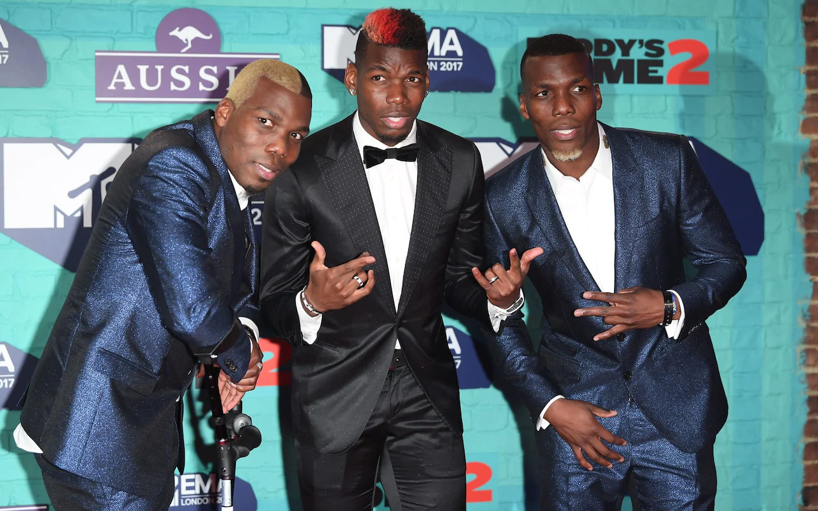


Slide 102
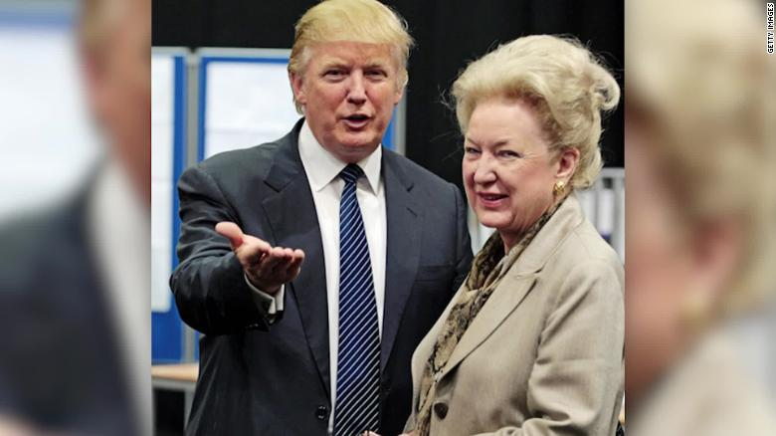


Slide 104
