Slide 2
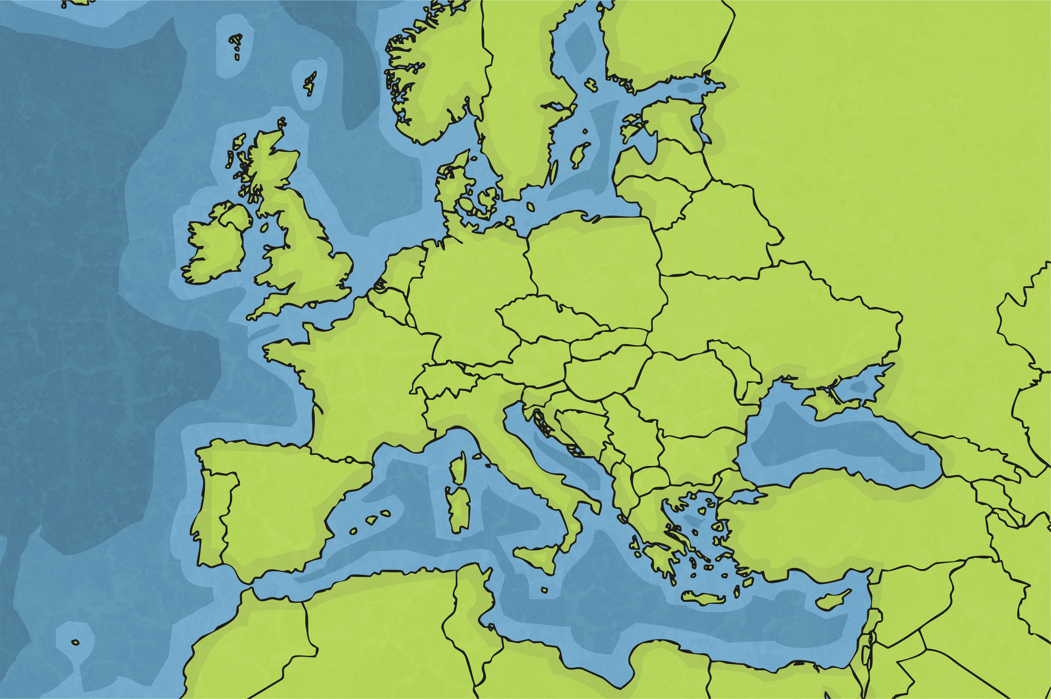
Where Is Spain?
Spain is a large country in Europe and shares borders with France and Portugal. It has the Mediterranean Sea on its east coast and the Atlantic Ocean on its north, west and south coast.
Spain

Slide 3
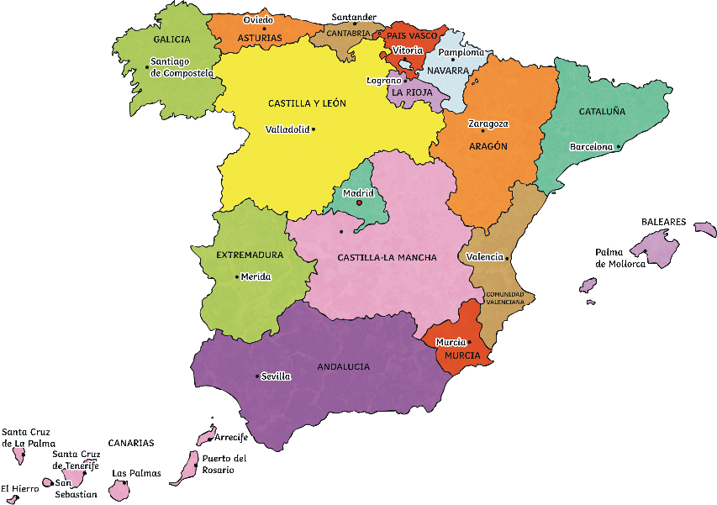
Spain Facts
Spain is officially called the Kingdom of Spain.
The capital city of Spain is Madrid.
The official language is Spanish.
The population of Spain is approximately 47,000,000.
Spain has very hot weather in the spring and summer, making it a popular holiday destination, especially with people from the UK. In winter, temperatures in some parts of Spain can get cold, sometimes below 0°C, and it can snow.
Madrid

Slide 4
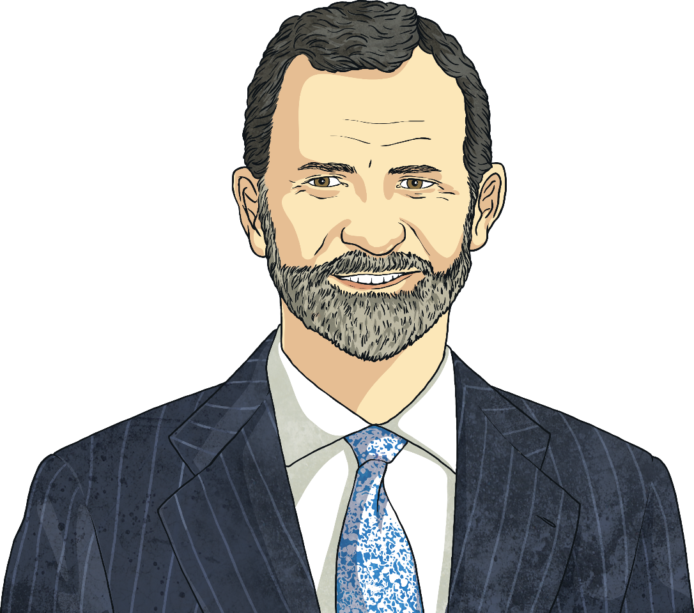
The Spanish Royal Family
Spain has a royal family just like in the United Kingdom. Felipe VI and Queen Letizia live with their two daughters, Leonor and Sofia, in Palace Zarzuela, on the outskirts of Madrid.

Slide 5
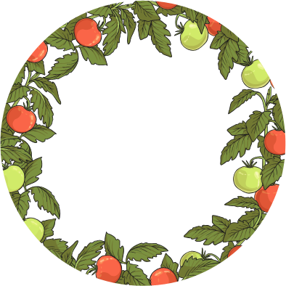
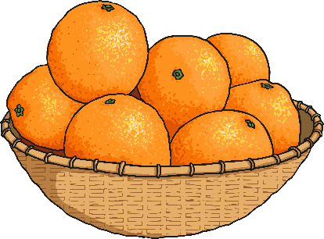
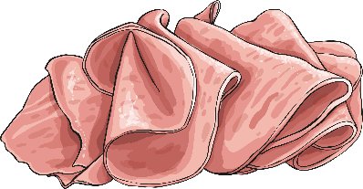
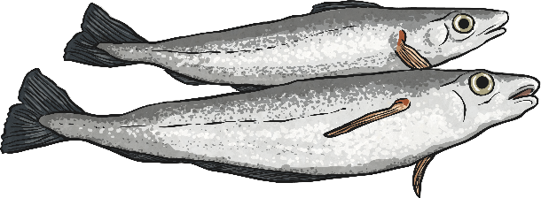
Spanish Food
The Spanish eat a mainly Mediterranean diet which consists of:
fresh fruits and vegetables;
a variety of seafood;
cured ham and meat.
Due to its proximity to the Mediterranean Sea and Atlantic Ocean and its sunny climate, Spanish food tends to be fresh, colourful and very healthy.
There are many traditional and varied Spanish dishes from different areas of the country, all influenced by the local environment and surroundings.

Slide 6
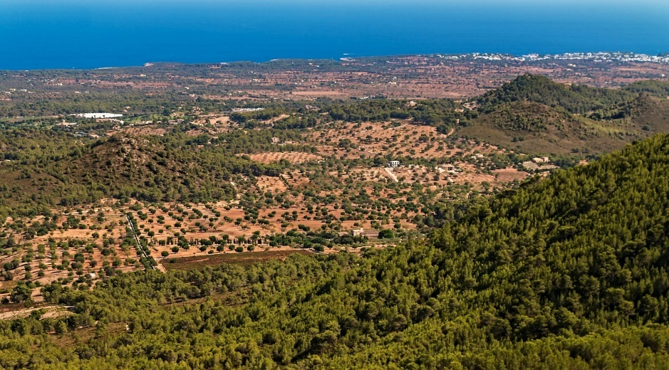
Spanish Food: Fruits and Vegetables
Different parts of Spain are famous for growing and producing different types of food. In the very hot and sunny south of Spain, there are large areas of woodland and orchards and many fruits and vegetables flourish there. In fact, they are so delicious that they are exported to countries all over the world! Olive oil is another popular food source produced in the south of Spain.

Slide 7
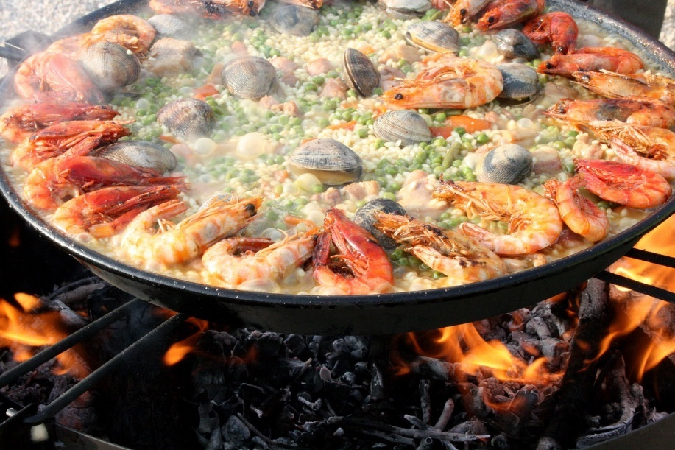
Spanish Food: Paella and Seafood
A very popular dish in Spain is paella, which originated in the city of Valencia on the east coast of Spain. This is traditionally cooked in a large pan. Common ingredients in paella are rice (Spaniards cook with Bomba rice), saffron, seafood and chicken.
Cod and tuna are the most commonly eaten fish in Spain. Some of the best fish is sourced off the north coast of Spain in areas such as Galicia, Asturias and Cantabria.

Slide 8
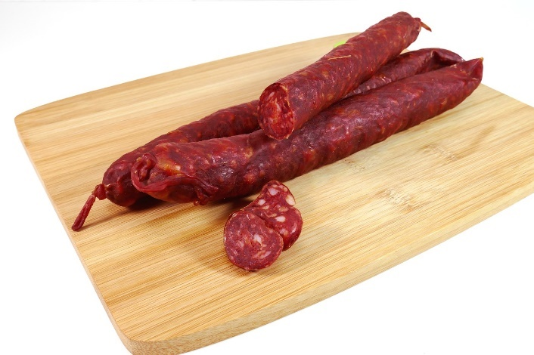
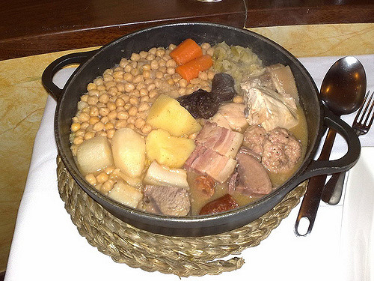
Spanish Food: Chorizo and Cocido
Chorizo is a Spanish sausage made from coarsely chopped pork and pork fat and seasoned with smoked paprika, which gives it its reddish hue. Chorizo can be either ‘picante’ (spicy) or ‘dulce’ (sweet).
Another popular Spanish speciality is a dish called cocido. This is a chickpea-based stew which is made with meat and vegetables.

Slide 9
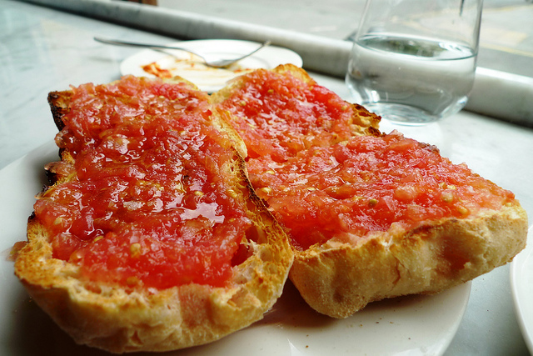
Spanish Food: Pan con Tomate
Pan con Tomate in English literally means ‘bread with tomatoes’ which describes exactly what this dish is. Pan con Tomate is a staple part of the Catalonian diet but is eaten regularly in most other areas of Spain. It can be eaten on its own as a snack or as an accompaniment to a meal at breakfast, lunch or dinner.
Catalonia is a north-eastern region of Spain. The vibrant city of Barcelona is in Catalonia.
Photo courtesy of Ewan Munro (@flickr.com) - granted under creative commons licence - attribution

Slide 10
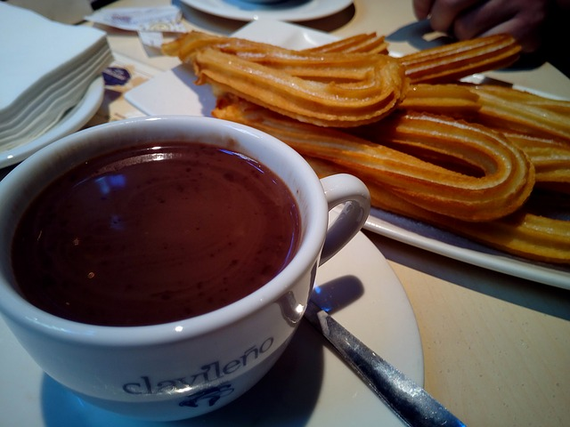
Spanish Food: Churro
A churro is a dough-pastry that is deep fried to give it a crunchy outer layer. Spaniards may eat churros for breakfast. Churros may also be dipped in chocolate sauce.
Do you fancy trying one?

Slide 11
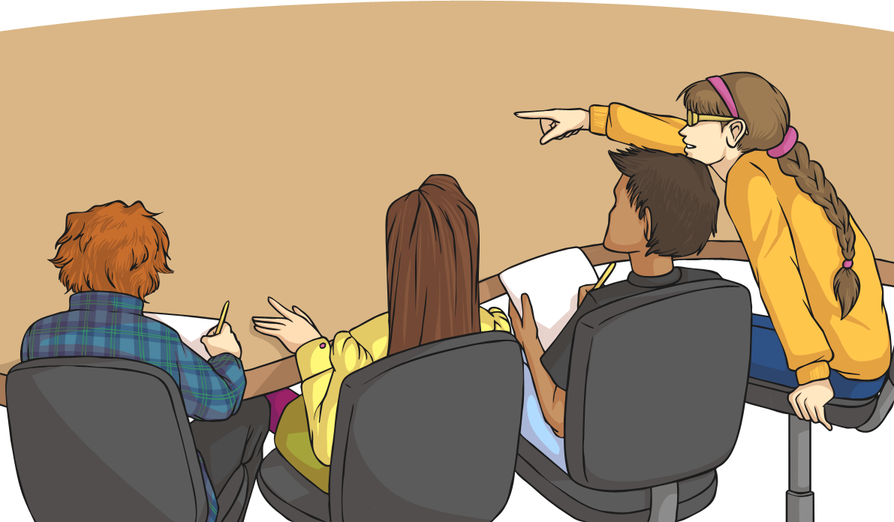
Spanish Schools
The Spanish education system is divided in to five levels: pre-school (ages 0-3), early childhood education (ages 3-6), primary (ages 6-12), compulsory secondary (ages 12-16) and post-compulsory education (ages 16-18).
Spanish children go to school for three terms of roughly 11 weeks and although they do not have as many half-term holidays as here in the UK, they have a longer summer holiday and lots of days off for festivals and non-teaching days.
Some schools may have a long two to three-hour break in the middle of the day during which many children go home for lunch with their families.

Slide 12
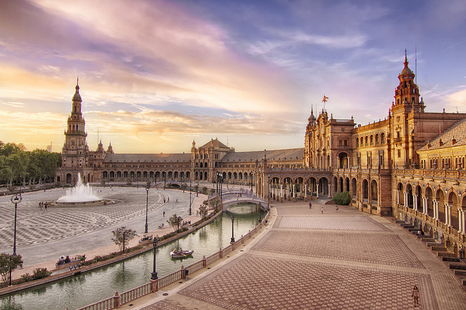
Plaza de España
The Plaza de España, which is in the city of Seville, is a popular tourist sight in Spain. Quite literally, in English it means ‘Spain Square’. It is an impressive, semi-circular brick building with tall towers on either side.
Photo courtesy of Francisco Colinet (@flickr.com) - granted under creative commons licence - attribution

Slide 13
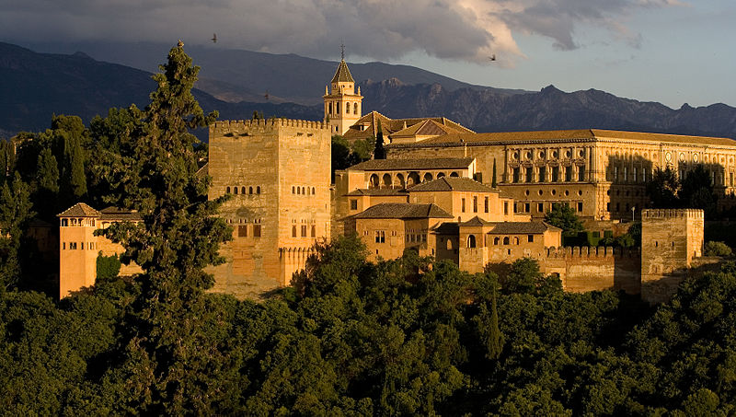
Alhambra
The Alhambra is a palace and fortress in Granada.
The building was converted into a palace in 1333 by Yusuf I, Sultan of Granada but has served many different purposes during Spain’s history.
The walls of the buildings have a reddish tint after being baked for years in the sun.
Photo courtesy of (@Wikimedia.org) - granted under creative commons licence - attribution

Slide 14
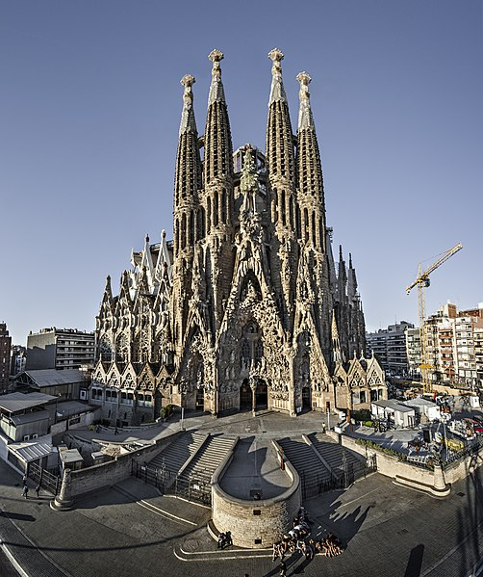
The Sagrada Familia
One of the most famous buildings in Spain is the unique Sagrada Familia. It is a large, Roman Catholic church in Barcelona and was designed by Antoni Gaudi.
However, despite building work starting in 1882, the building is still unfinished! Gaudi worked on the building for 40 years but sadly died in 1926, before it was completed. Since then, several builders and architects have taken over but it is still incomplete. It is hoped that construction will be finished in 2026, which will mark the centenary of Gaudi’s death.
Photo courtesy of (@Wikimedia.org) - granted under creative commons licence - attribution

Slide 15
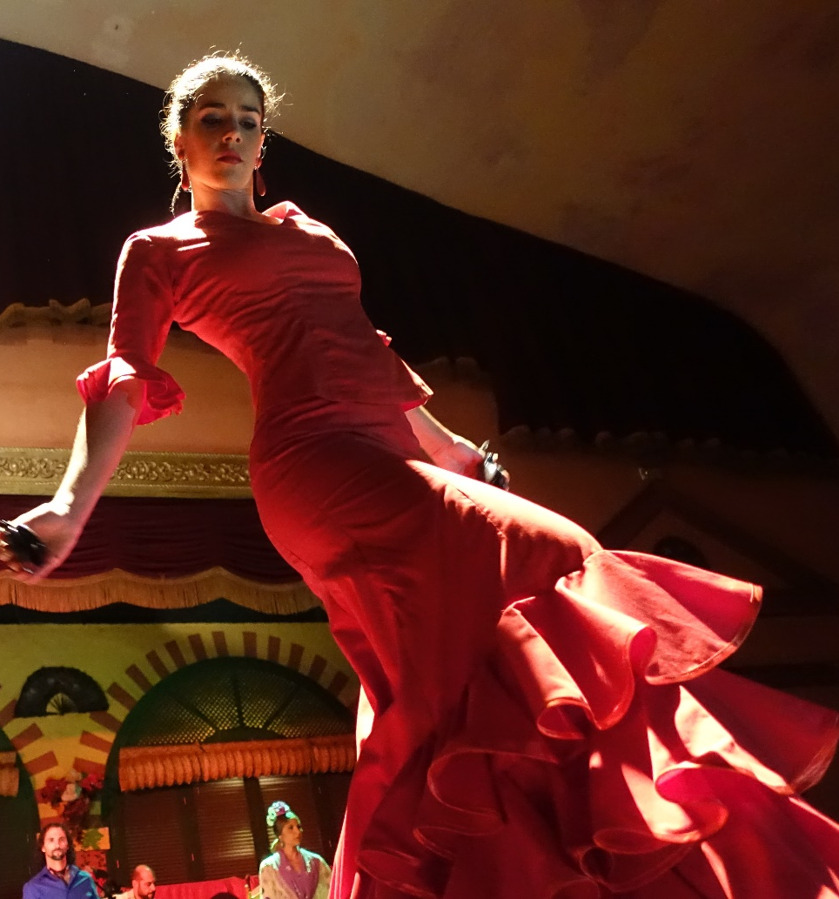
Flamenco Dancing
An important part of Spanish culture is flamenco dancing. It started in Andalusia in Spain, but it is now popular all over the world. Flamenco dancing is famous for its heel stamps, hand claps and castanets. Originally, flamenco had no music and the dance was accompanied by singing and hand clapping alone, known as ‘toque de palmas’.
Photo courtesy of (@Wikimedia.org) - granted under creative commons licence - attribution

