Slide 1
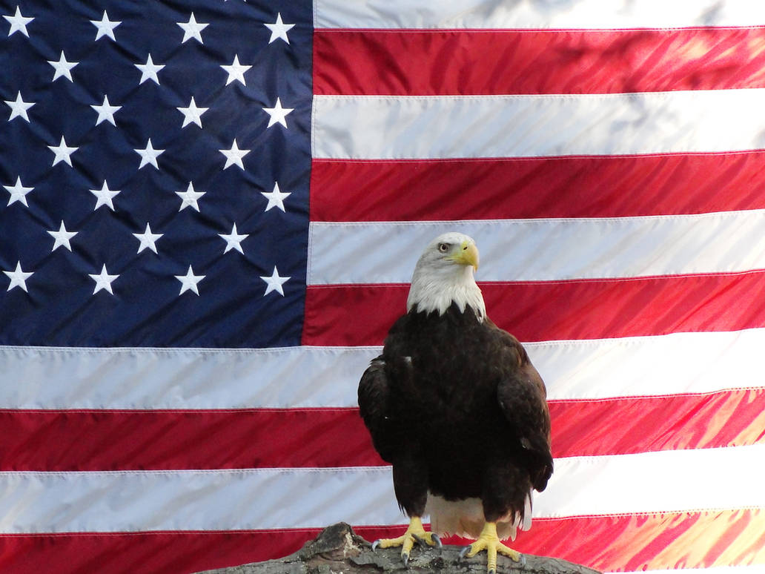
The United States of America
By TJ
This Photo by Unknown Author is licensed under CC BY-NC

Slide 2

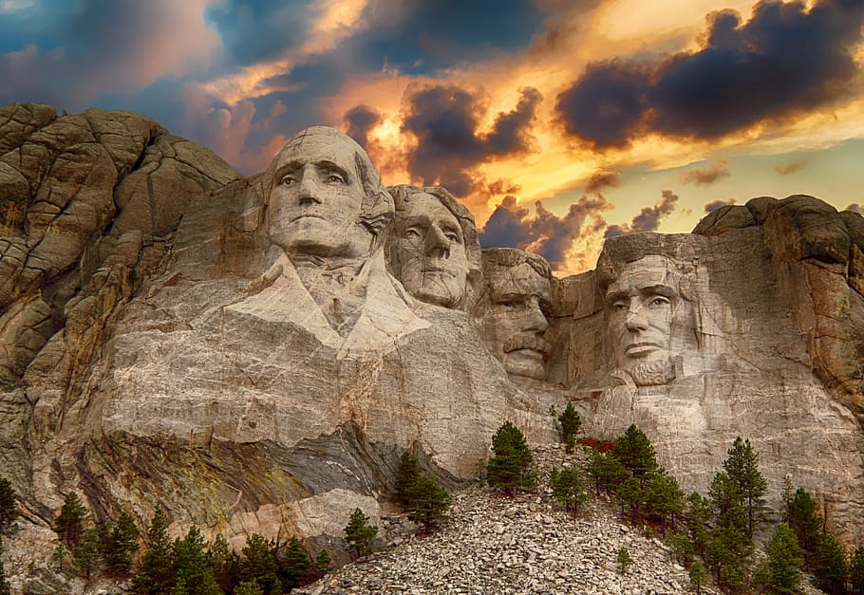
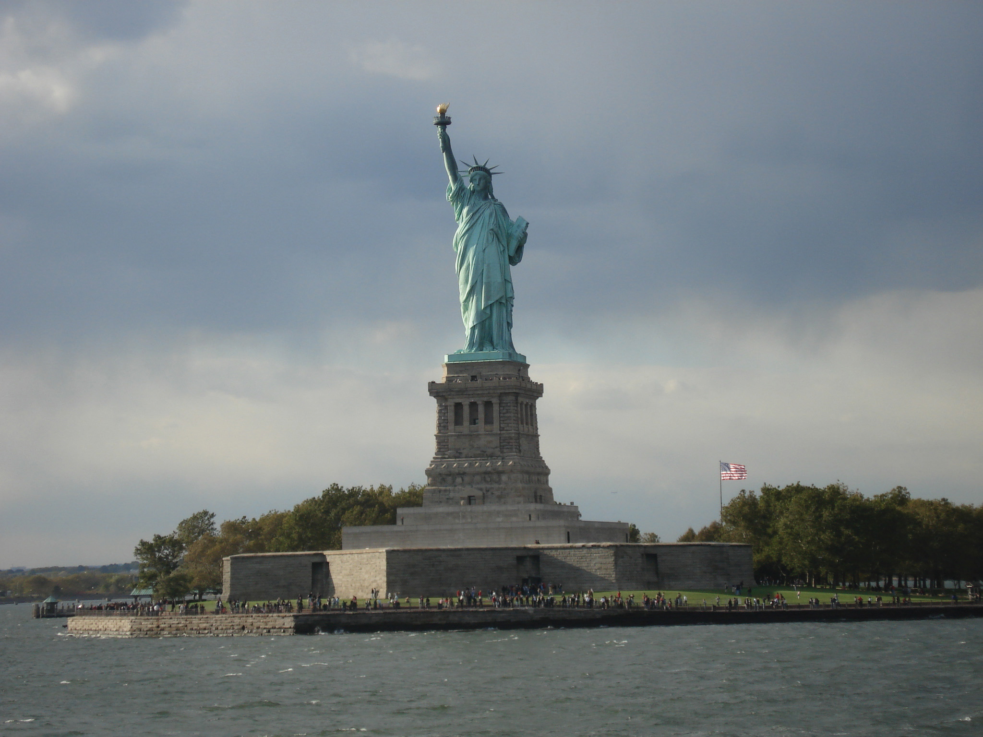
Famous Landmarks
Mount Rushmore
Statue of Liberty
This Photo by Unknown Author is licensed under CC BY-SA-NC

Slide 3
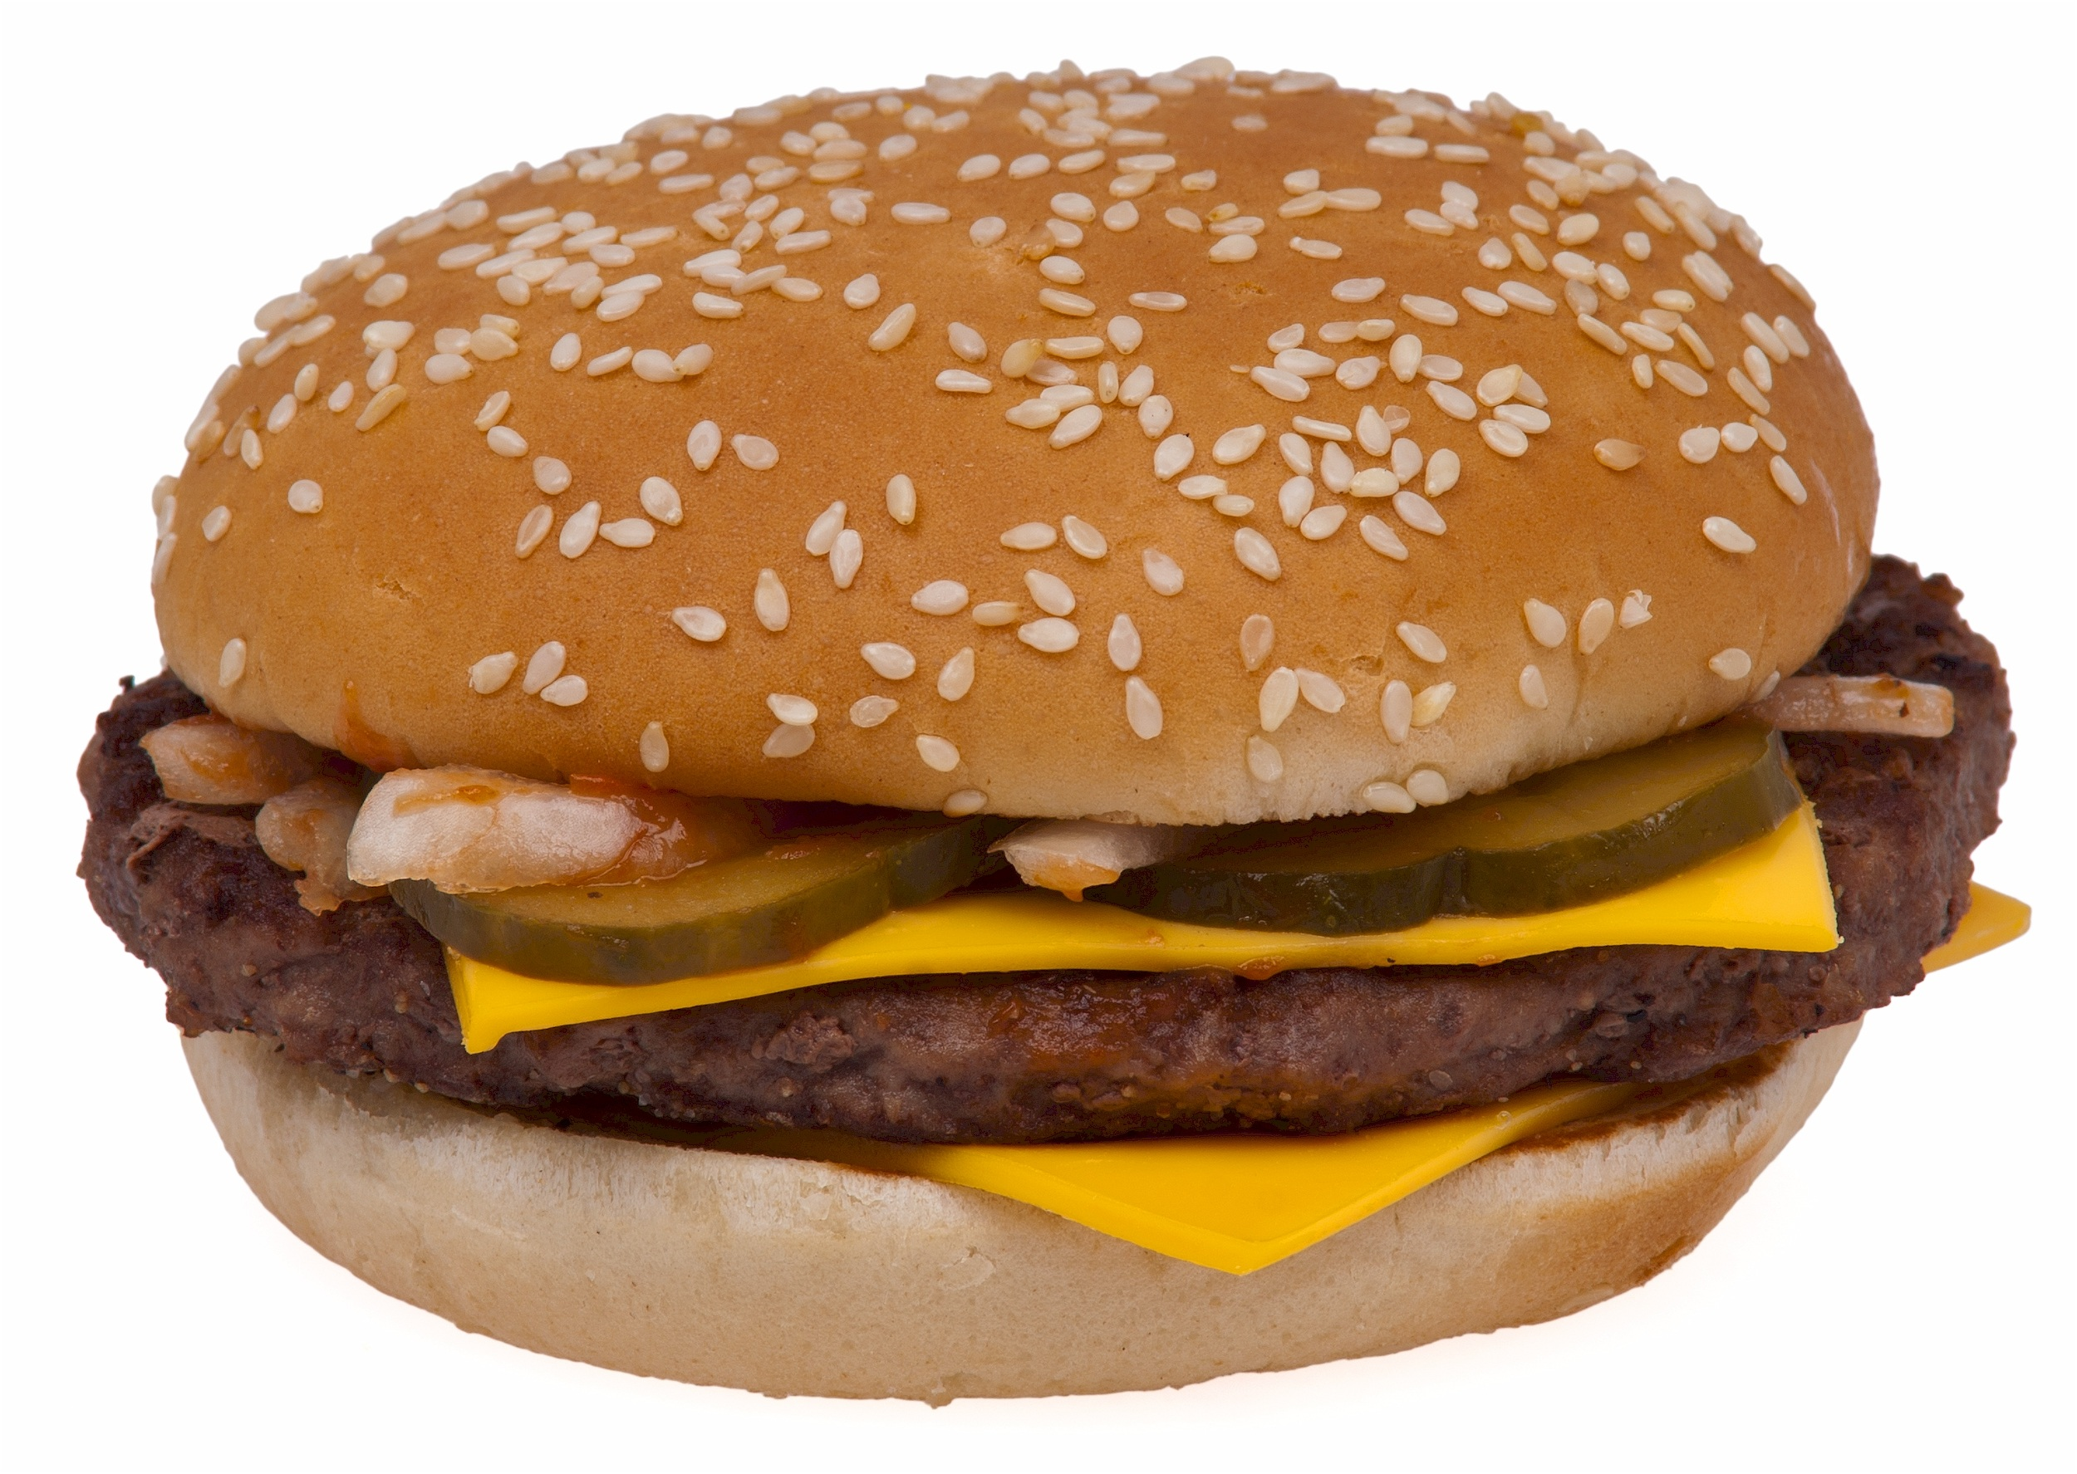
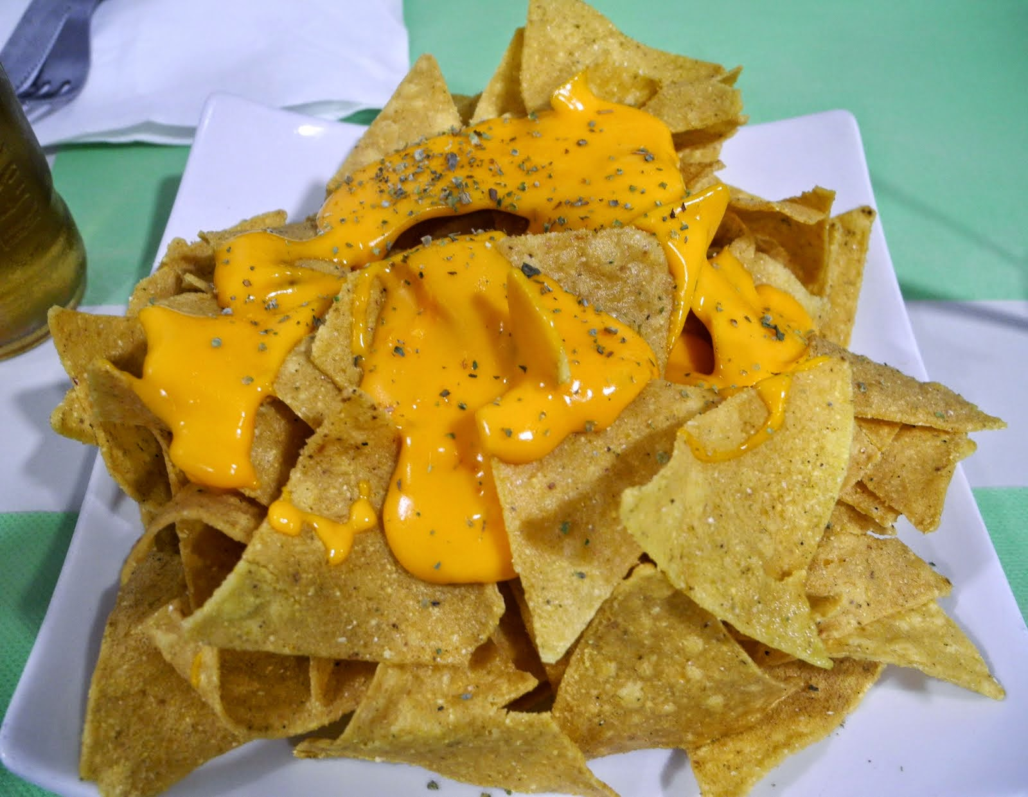
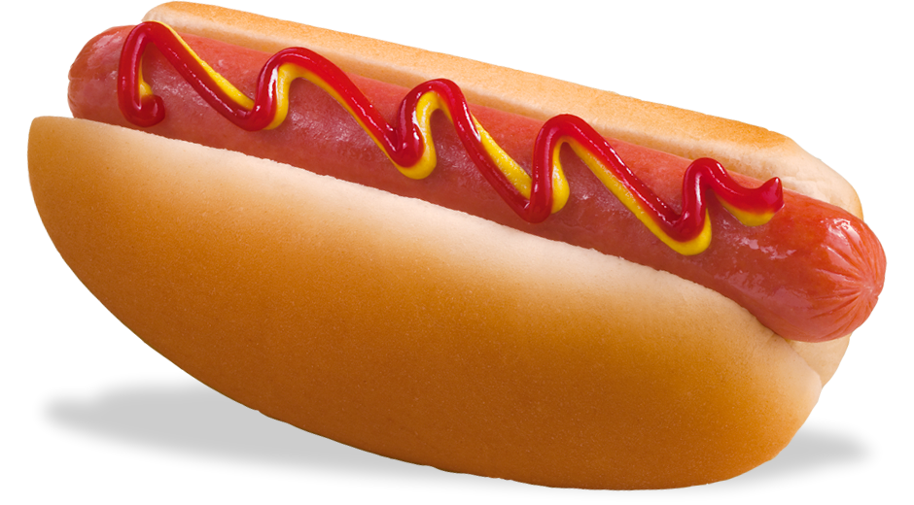
Famous American Food
This Photo by Unknown Author is licensed under CC BY-NC-ND
This Photo by Unknown Author is licensed under CC BY-NC

Slide 4
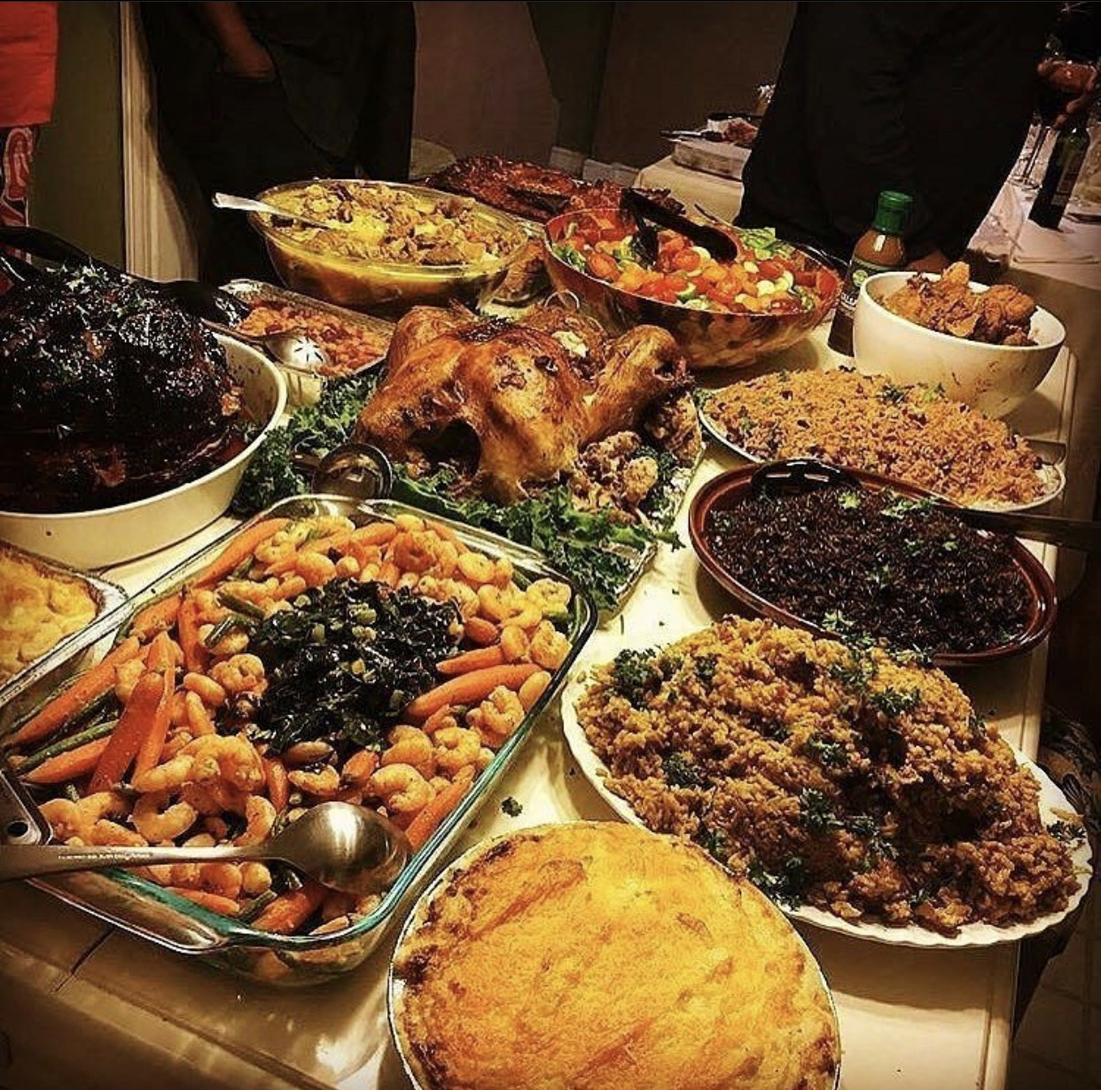
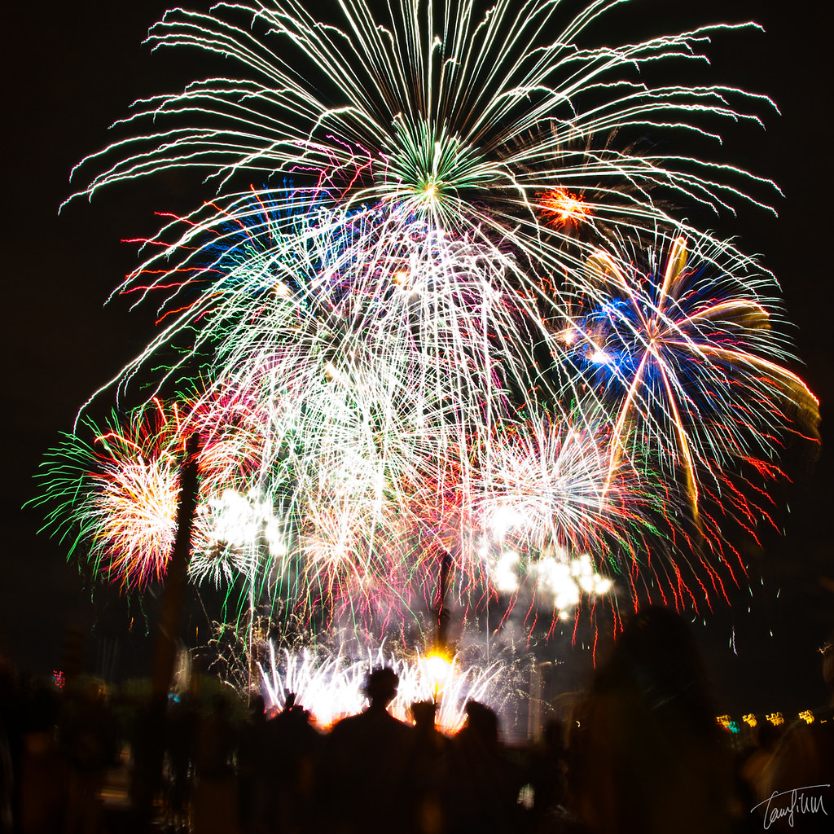
Traditions in the USA
Thanksgiving
Independence Day (July 4th)
This Photo by Unknown Author is licensed under CC BY-ND
This Photo by Unknown Author is licensed under CC BY-ND

Slide 5
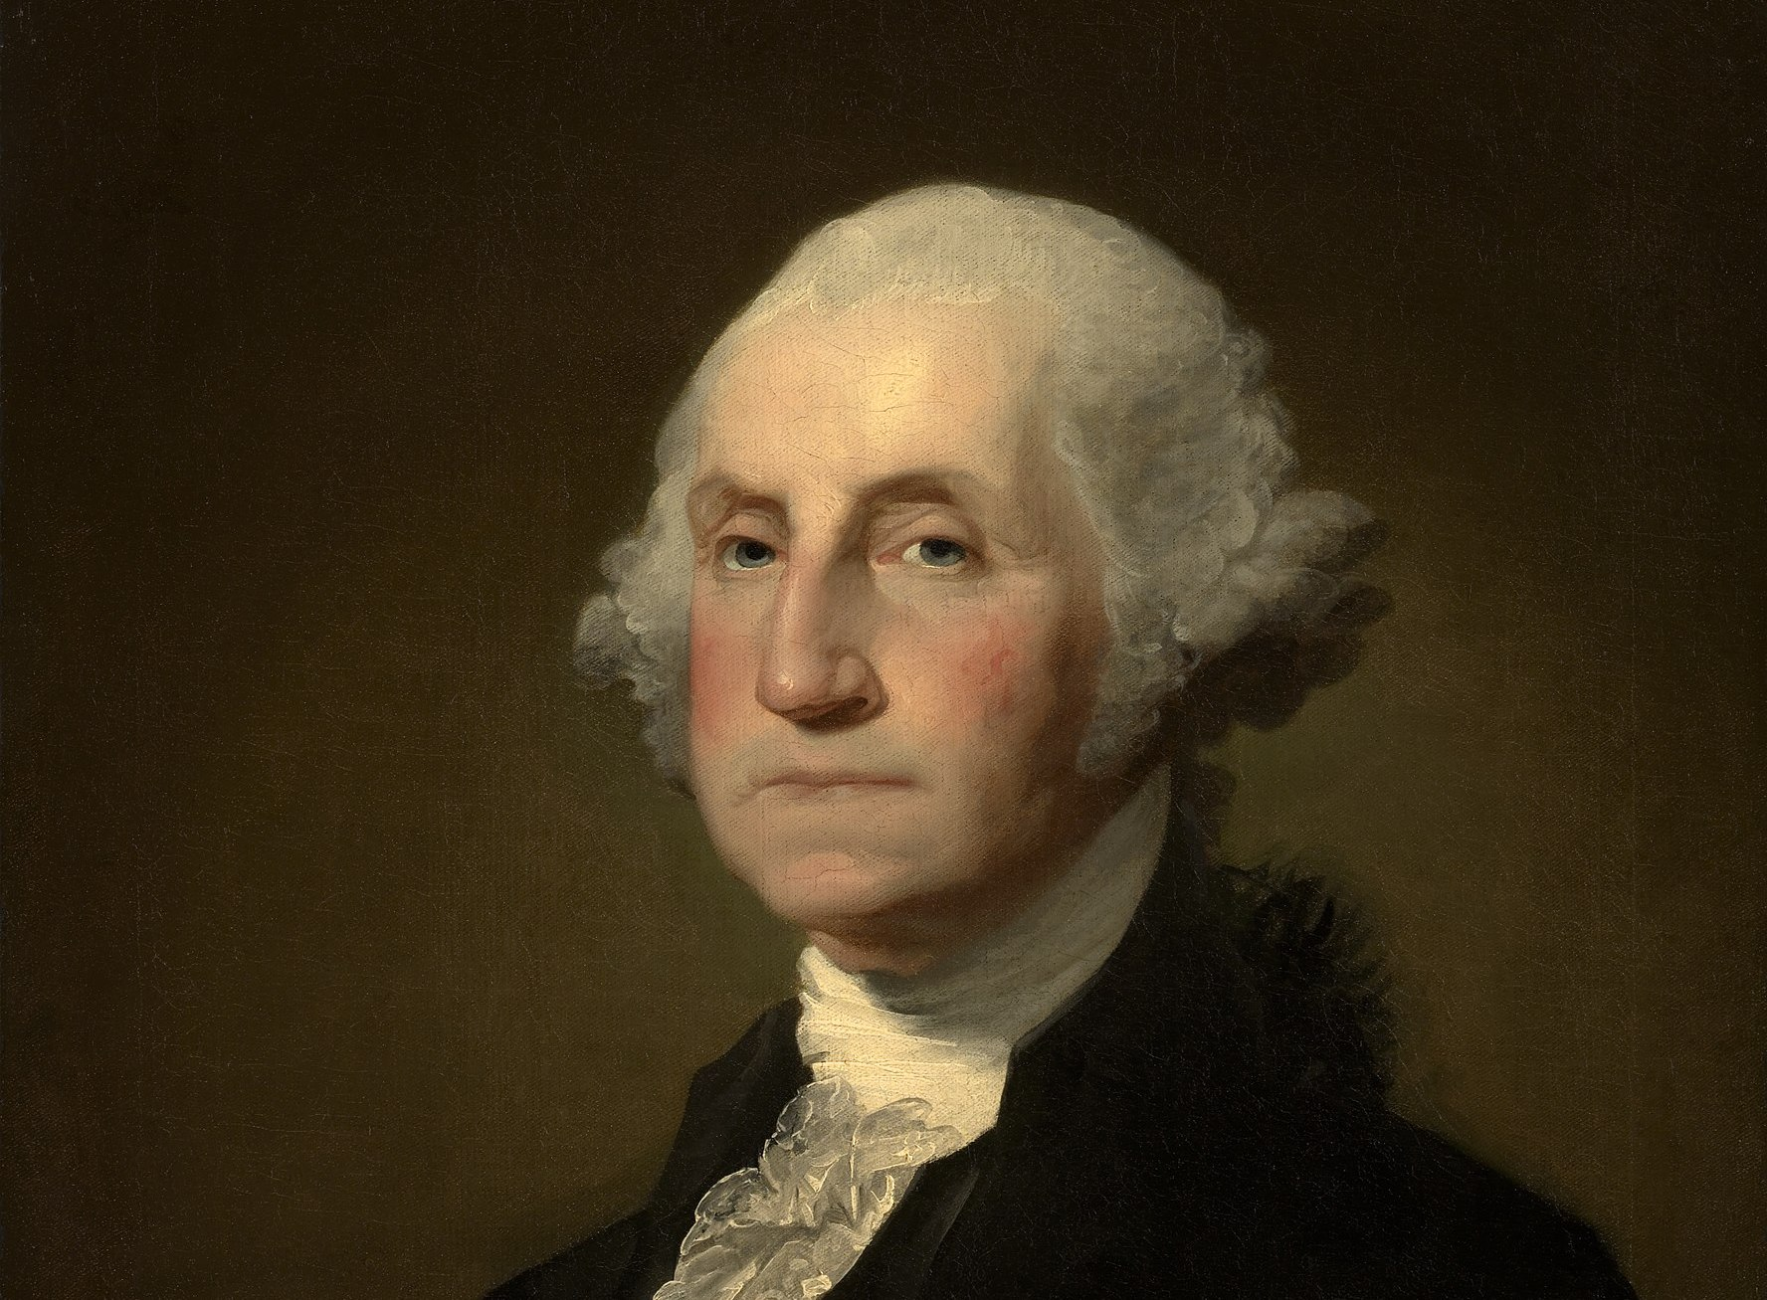
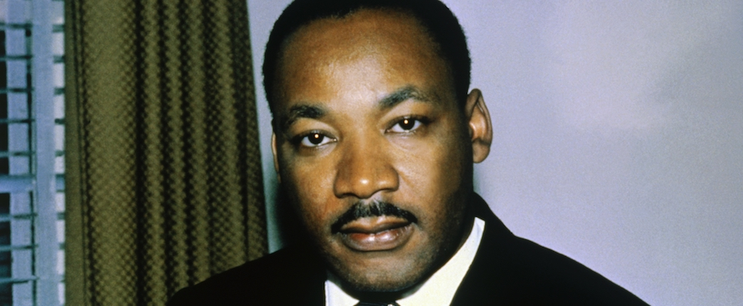
Famous People
George Washington
Martin Luther King. Junior
This Photo by Unknown Author is licensed under CC BY-SA-NC
This Photo by

Slide 6
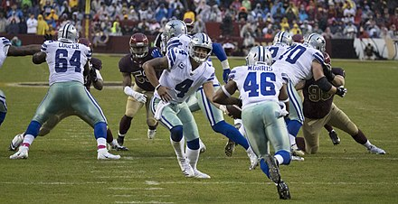
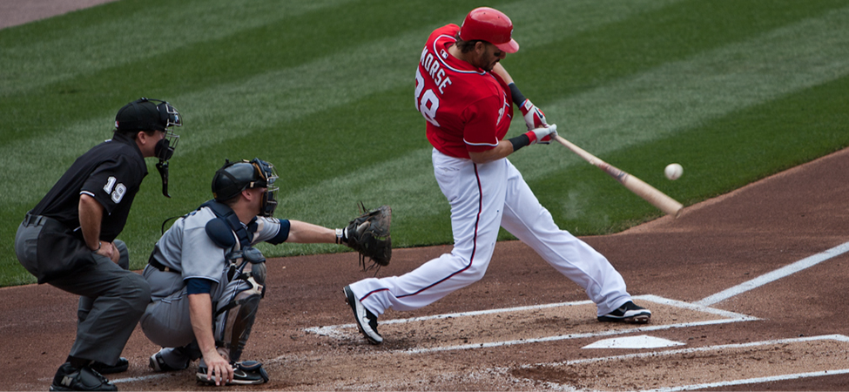
Activities and Sports
American Football (NFL)
Baseball
This Photo by Unknown Author is licensed under CC BY-SA
This Photo by Unknown Author is licensed under CC BY

Slide 7

The Star-Spangled Banner (American National Anthem)
The Star-Spangled Banner was written by a lawyer. It’s named after the American flag. The lyrics comes from a poem.
This Photo by Unknown Author is licensed under CC BY-SA-NC

Slide 8
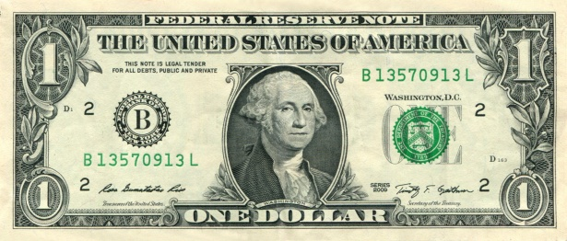
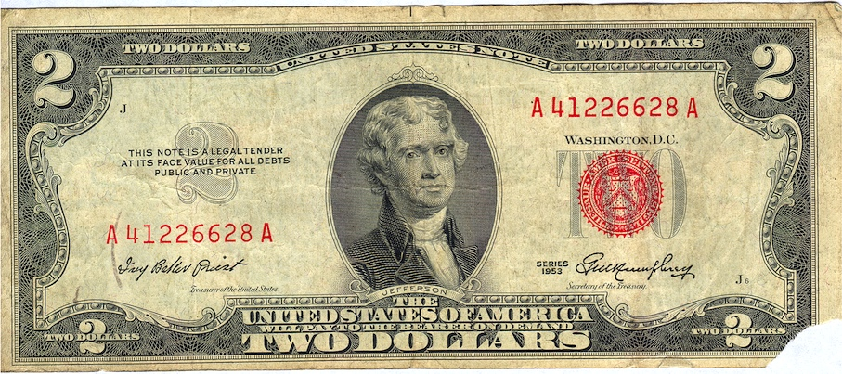
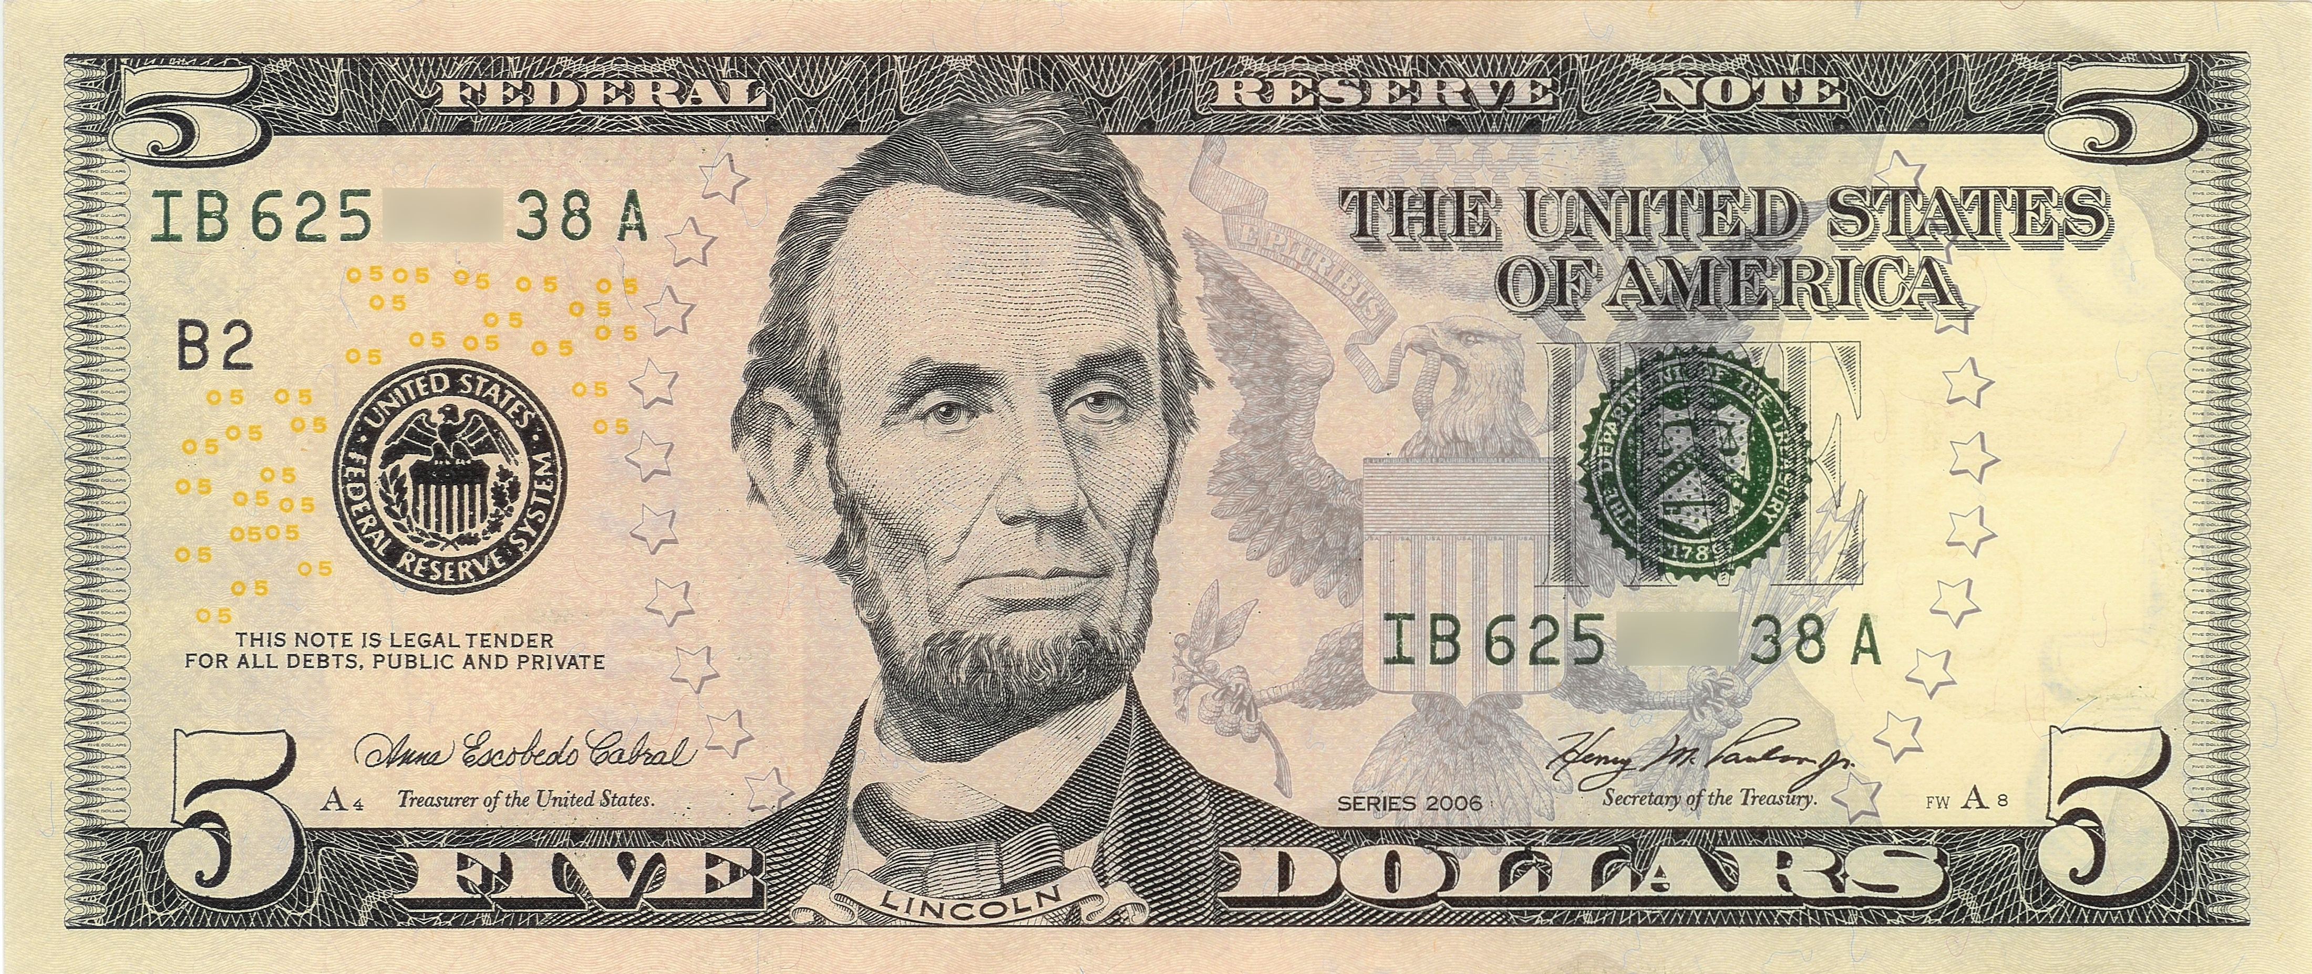
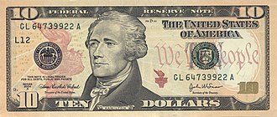
Currency in America
This Photo by Unknown Author is licensed under CC BY-SA-NC
This Photo by Unknown Author is licensed under CC BY-SA

Slide 9
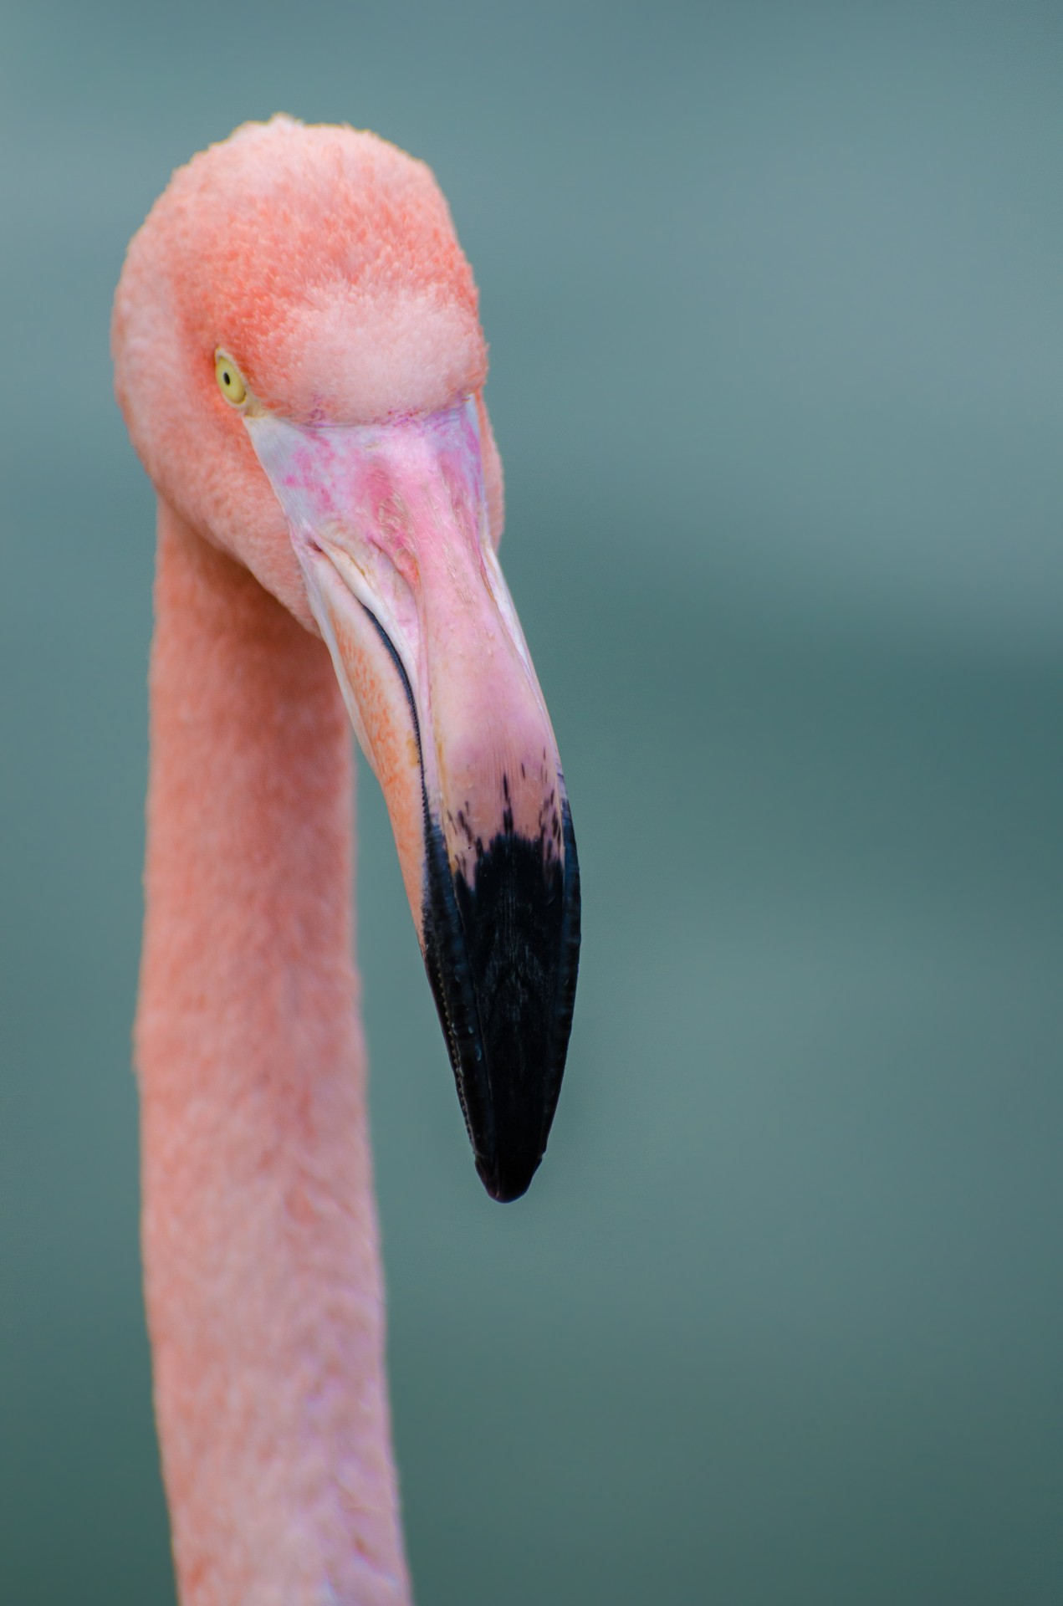

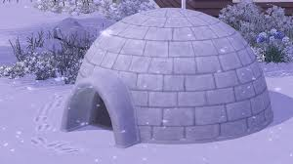

Thanks for watching
This Photo by Unknown Author is licensed under CC BY-NC
Mr. FlimFlam Says thanks

