Slide 1
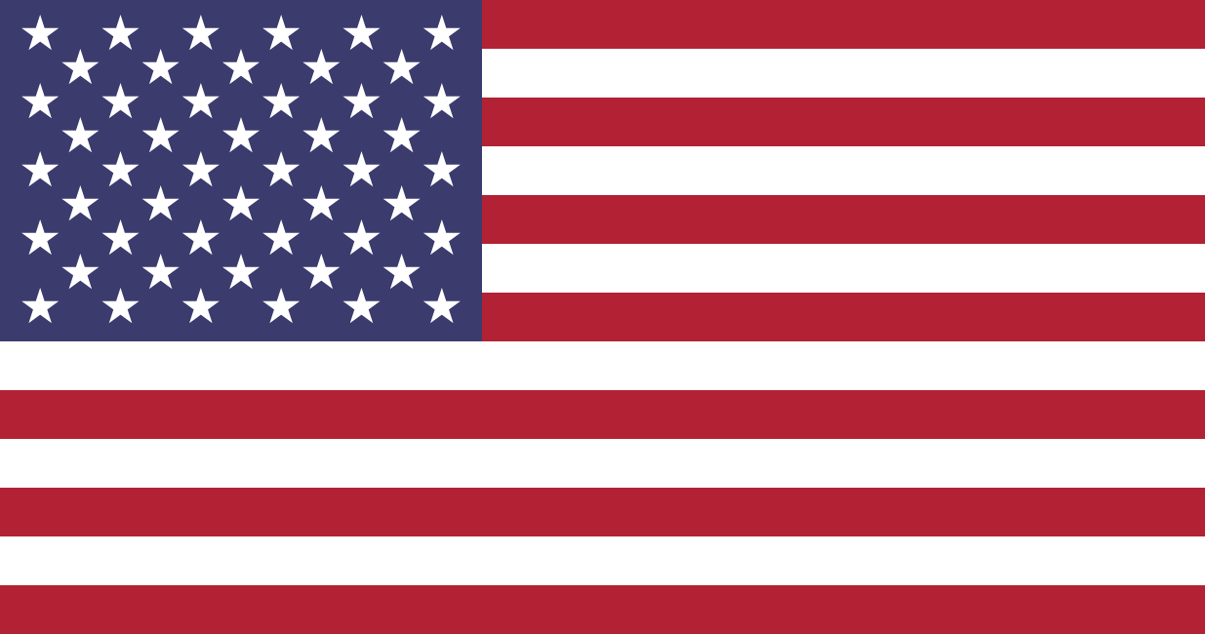
USA
©Tsikhan Zubialevich

Slide 2
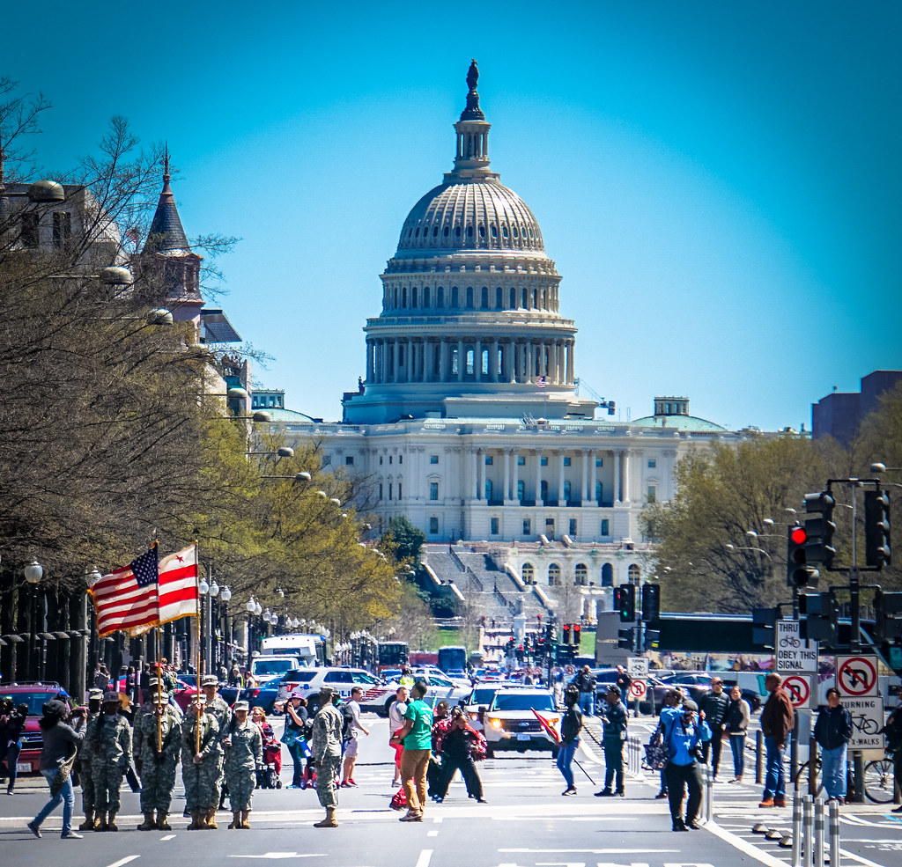
Capital City
The capital City of USA is Washington D.C Named after the First President of The USA and the Army Leader.
Washington D.C Is 232 Years old.
The Population is 712,816 (2020).
D.C stands for District of Columbia.

Slide 3
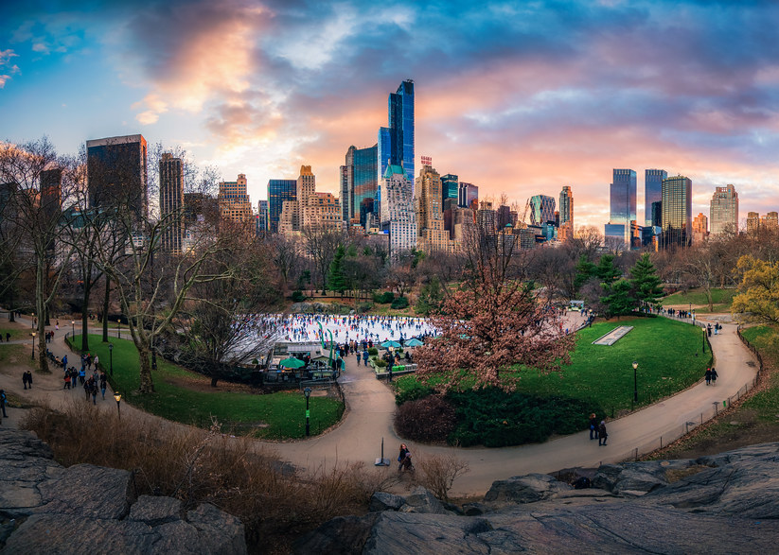
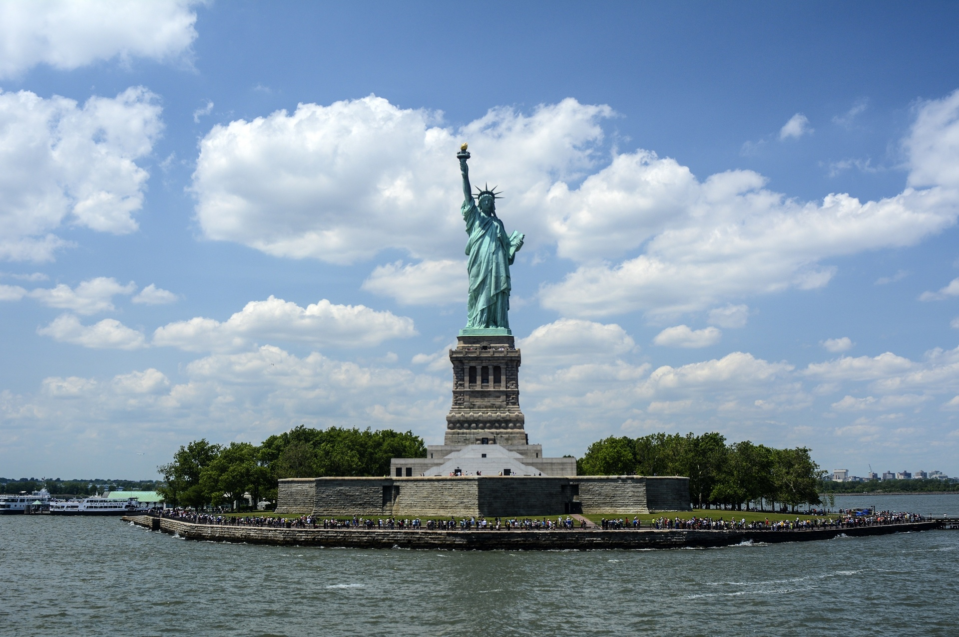
Famous Land Marks

Slide 4
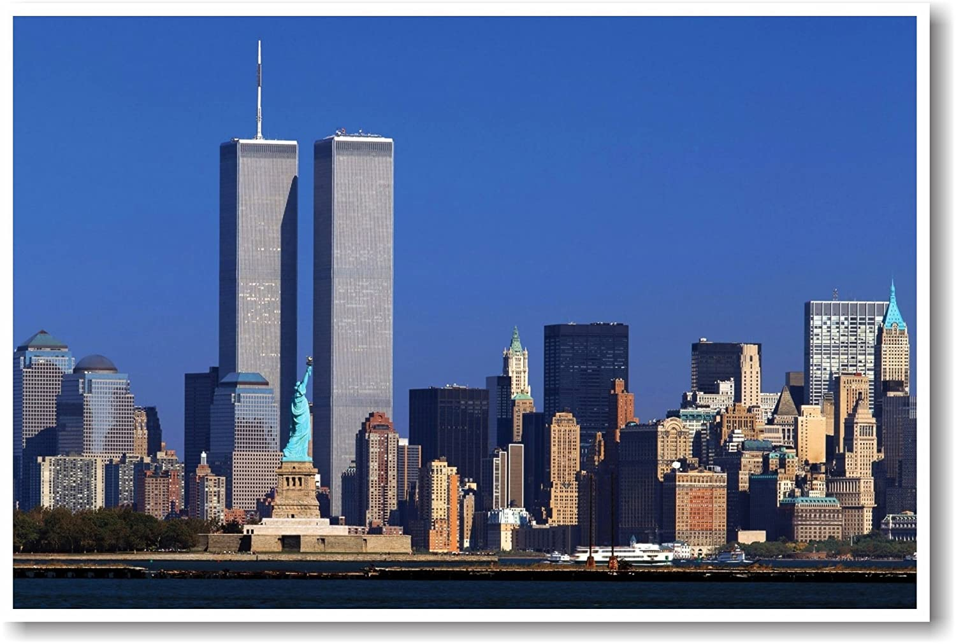
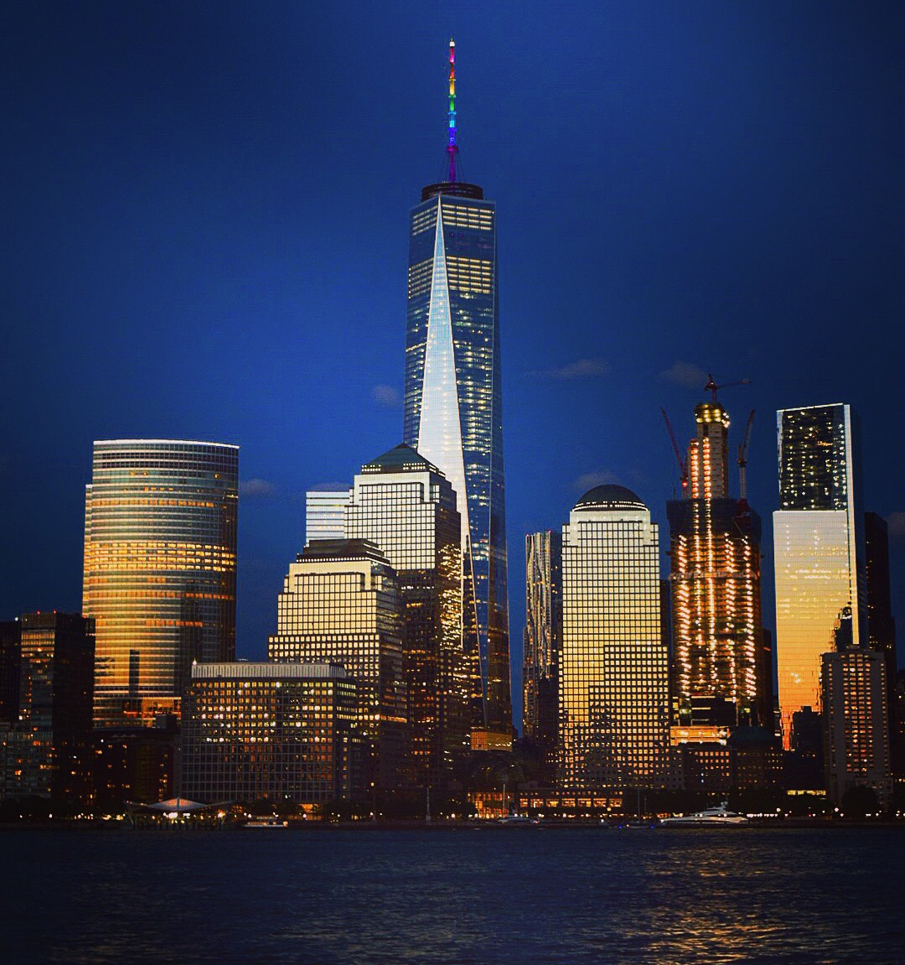
The Twin Towers/World Trade Centre
Before
After

Slide 5
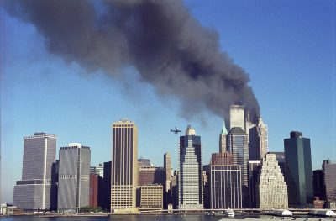
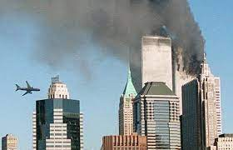
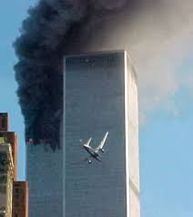
The 9/11
September 11, 2001 at 1:14 PM GMT+1, This is the time when a very bad incident occurred .
A famous person by the name of Osama Bin Ladin had hijacked an aircraft heading to New York but it headed straight into the towers.
Very sad day for the Americans.

Slide 6
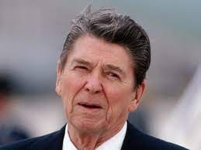
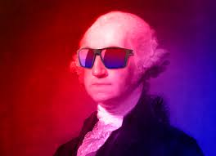
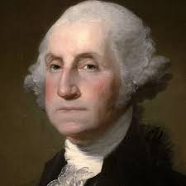
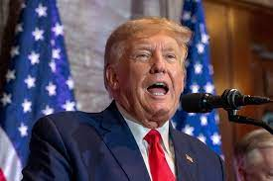
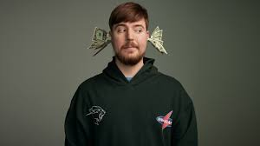
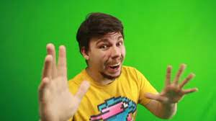

Famous People
George Washington First US President.
Mr Beast Famous Youtuber from North Carolina.
Ronald Reagan The 40th President of America
Donald Trump 45th US President
John F. Kennedy 35th US President

Slide 7
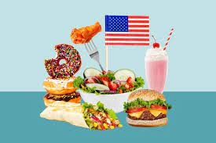
Famous Food
Ice Cream.
Chicken Tenders.
Soft Drinks/Soda.
Pizza.
Oreo Cookies.
French Fries.
Hot Dogs.
Hamburgers.

Slide 8
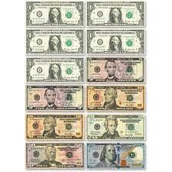
Money
$1, $2, $5, $10, $20, $50, $100, $500 , $1000, $5000, $10000 These Are all of the Cash In America

Slide 9
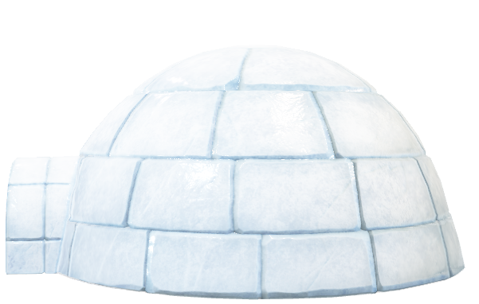
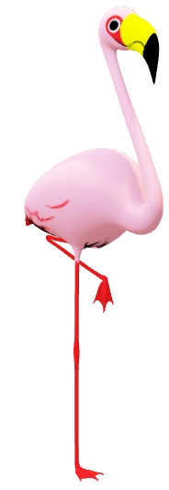

Fun Fact We are Done
Fun Fact I have nothing to show to you anymore.
Hi
EL Chigloos Iglloo

