Slide 1
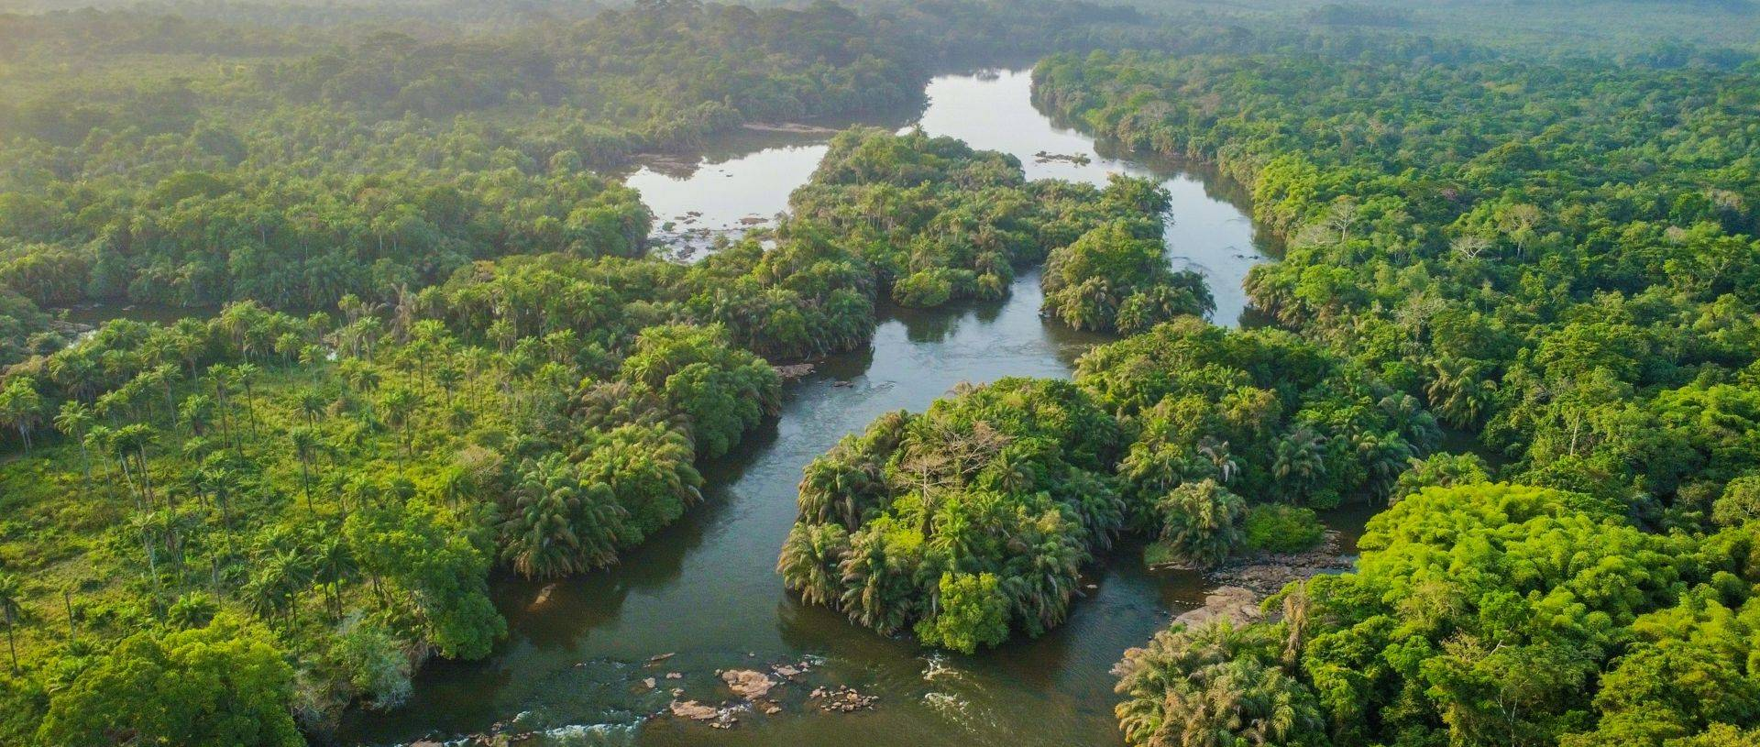
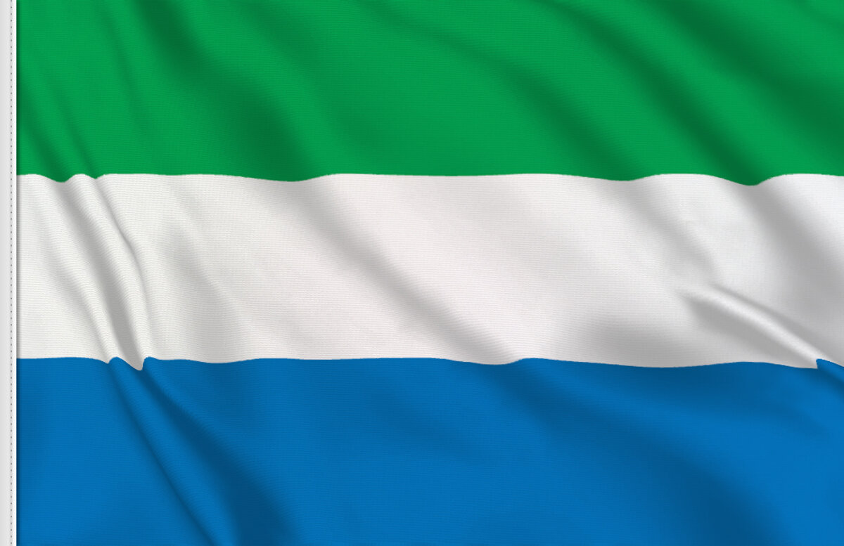
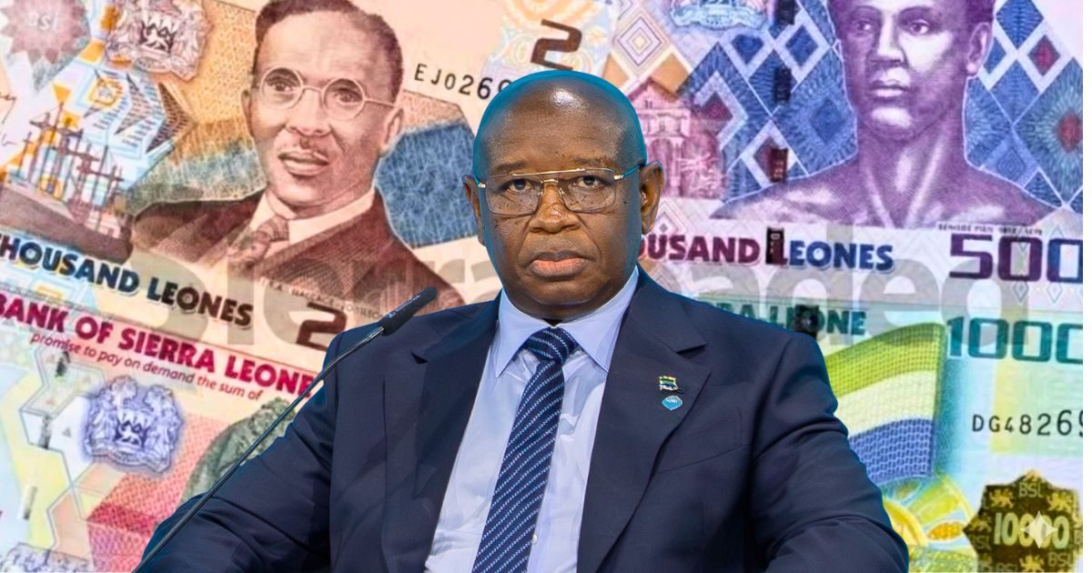
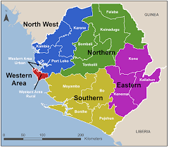
Sierra Leone
By Emmet Blackwell

Slide 2
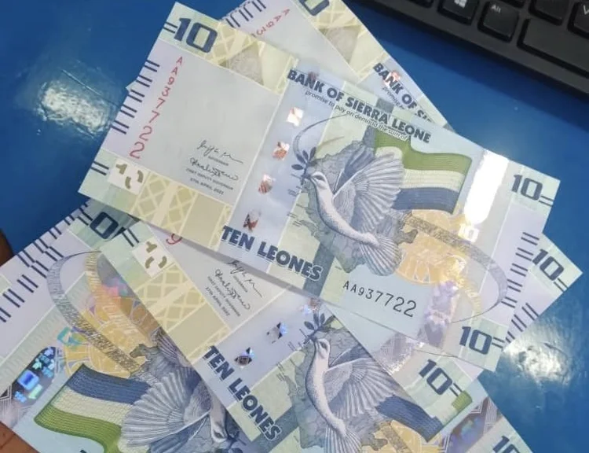
Facts
      Population: 8.9 million
      Location: West Africa
      Languages spoken: English, Krio
      Independence Day: 27 April 1961
      Currency: Sierra Leonean Leone
      The country is facing a food crisis
      Child marriage became illegal in July 2024
      World Vision aims to reach 1.7 million children in the country

Slide 3
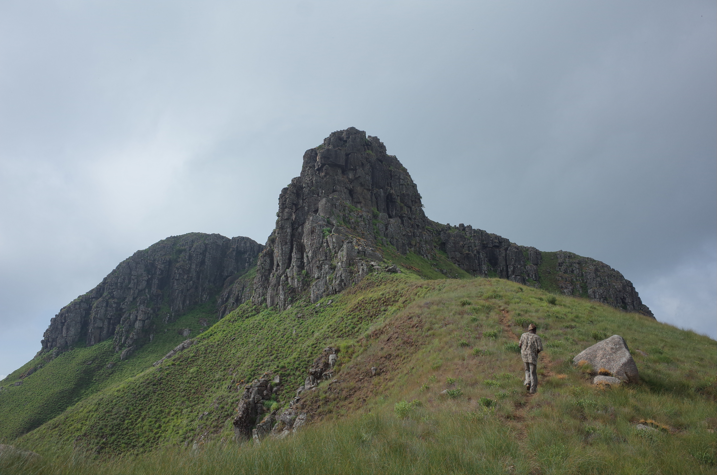
Geography
Sierra Leone is a tropical West African nation covering 71,740
on the Atlantic coast, bordered by Guinea and Liberia. Its diverse geography features a 400-km coastal mangrove belt, central agricultural plains, and an eastern plateau with mountains, including the highest peak, Mount Bintumani (1,948m). The climate is hot and humid, defined by distinct rainy (May-Nov) and dry (Dec-May) seasons.
Sierra Leone, located on the West African coast, is characterized by a 400 km Atlantic coastline with mangrove swamps, interior plains, and an eastern mountainous plateau. The terrain ranges from low-lying coastal land to the 1,948-meter-high Mount Bintumani (Loma Mountains). It has a tropical climate with high rainfall, and is divided into four main physical regions, including the rocky, forested Freetown Peninsula.

Slide 4
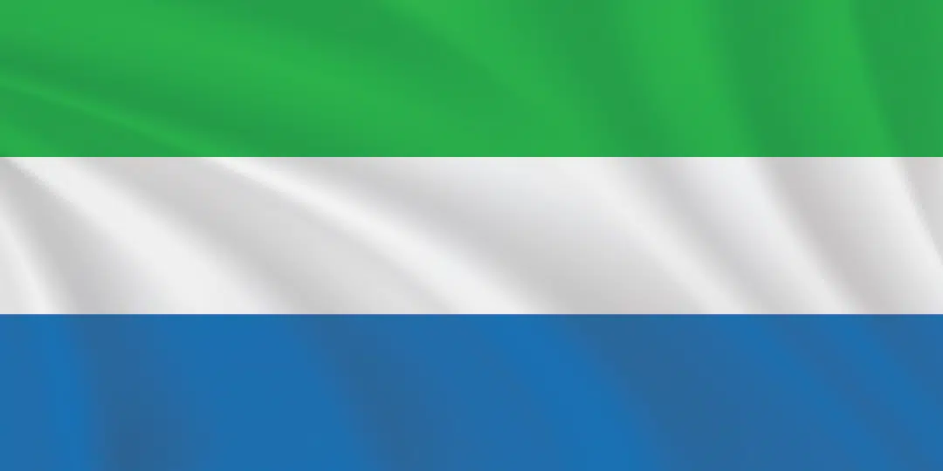
Flag
The national flag of Sierra Leone, adopted upon independence on April 27, 1961, is a tricolor featuring three equal horizontal bands of light green, white, and light blue. The green represents agriculture, mountains, and natural resources; white symbolizes unity and justice; and blue represents the Atlantic Ocean and the natural harbor of Freetown.

Slide 5
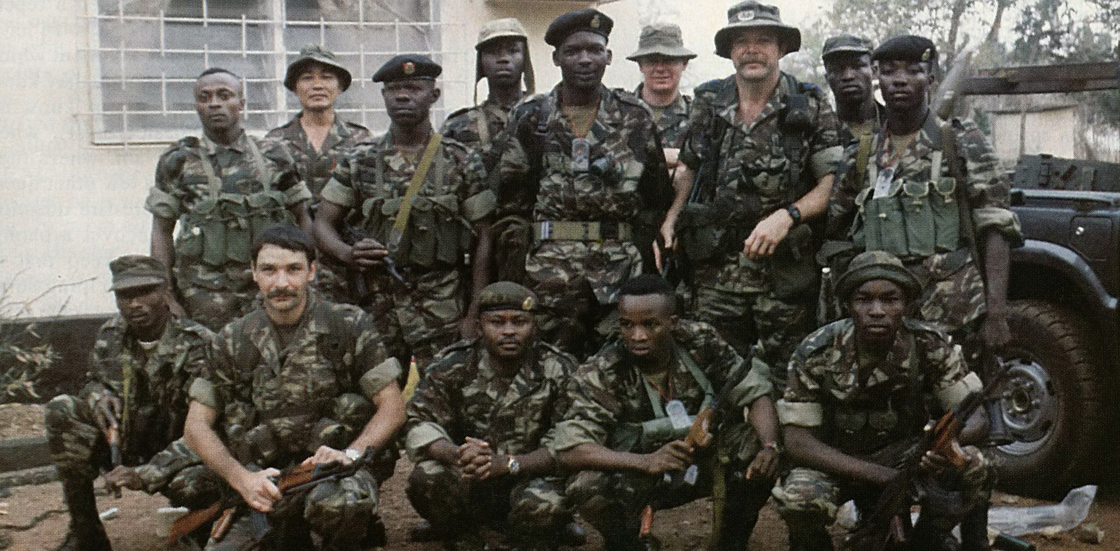
History
Sierra Leone’s history, spanning over 2,500 years of habitation, is defined by its role in the transatlantic slave trade, its founding in 1787 as a "Province of Freedom" for repatriated slaves (Freetown), and its independence from Britain in 1961. Following decades of instability and a brutal 1991–2002 civil war fueled by "blood diamonds," the nation has focused on peacebuilding, democratic consolidation, and economic recovery.

Slide 6
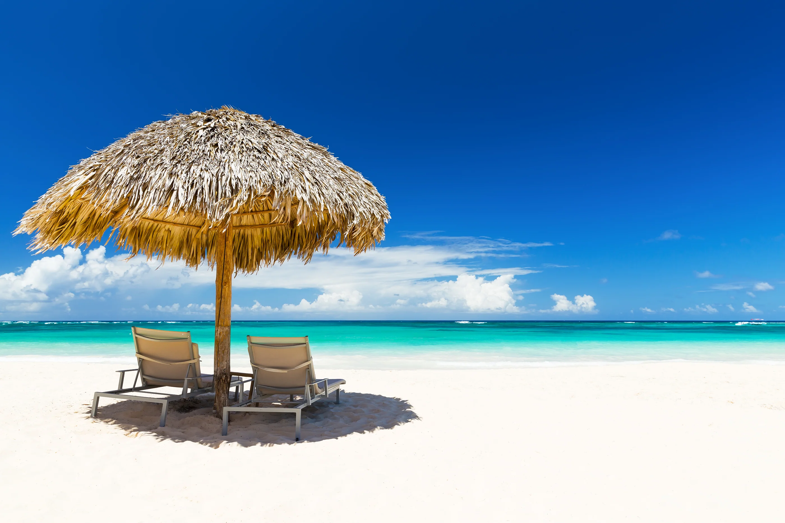
Climate
In Sierra Leone they have a tropical monsoon climate with tempatures at the average of 26 C – 36 C with two distinct seasons

Slide 7
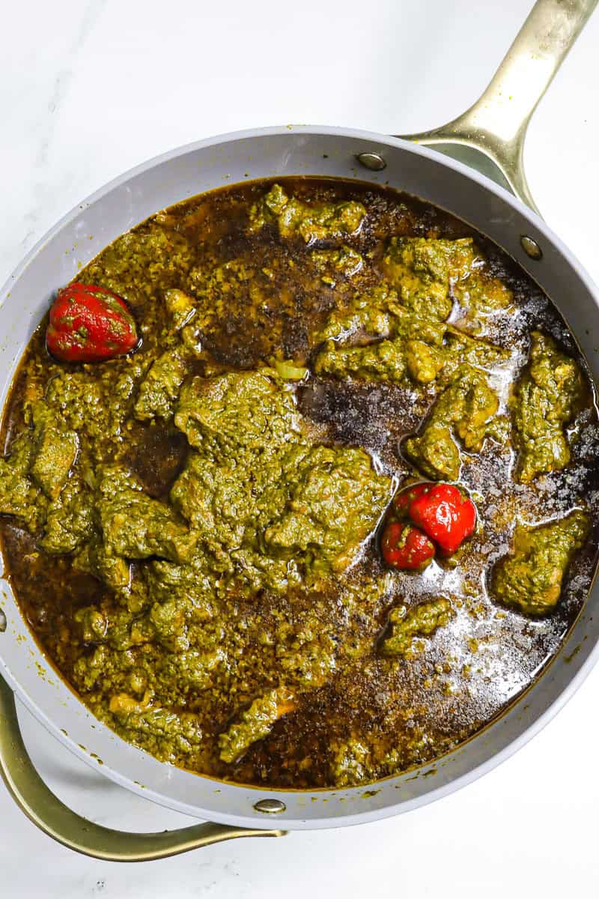
Food & drink
Cassava leaf stew (Plassas): A rich stew made with finely pounded cassava leaves, palm oil, fish or meat, and often peanut butter.
Groundnut stew: A savory, creamy stew made from peanut butter, tomato paste, chili, and meat or fish.
Oleleh: Steamed bean cakes, often wrapped in leaves.

Slide 8
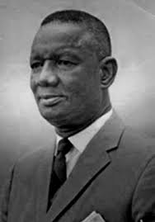
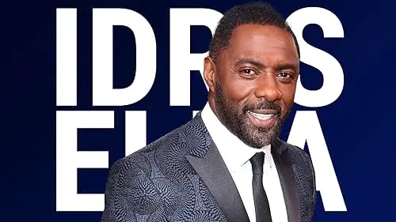
Famous People
Famous people from Sierra Leone include first Prime Minister Sir Milton Margai, actor Idris Elba (via his father), rapper Kao Denero, and historical figures like Bai Bureh and Sengbe Pieh. Other notable individuals include Princess Sarah Culberson and various political leaders like Siaka Stevens and Ernest Bai Koroma.
Prime Minister Sir Milton Margai
actor Idris Elba

Slide 9
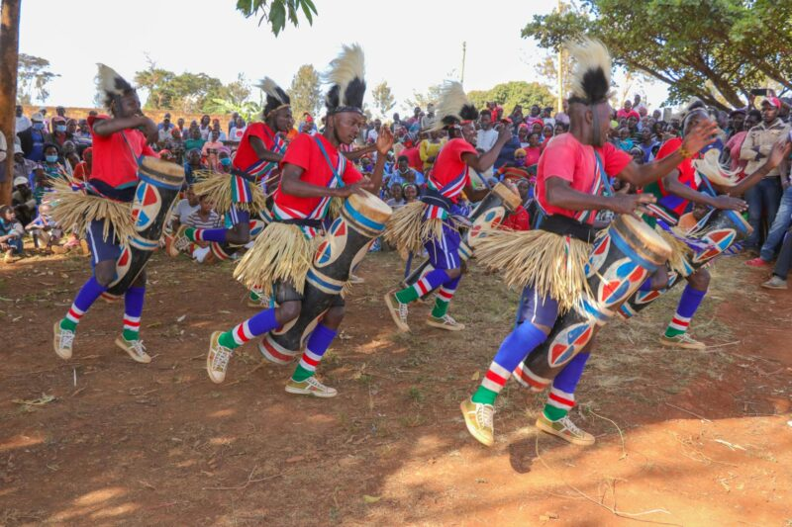
Culture
Sierra Leonean culture is defined by its deep-rooted hospitality, vibrant music, and diverse traditions stemming from 18+ ethnic groups, notably the Mende and Temne. Famous cultural elements include the internationally acclaimed National Dance Troupe, energetic Bubu music, the annual Tangains Festival, and a profound respect for elders, often featuring complex masked performances (masquerades).

Slide 10
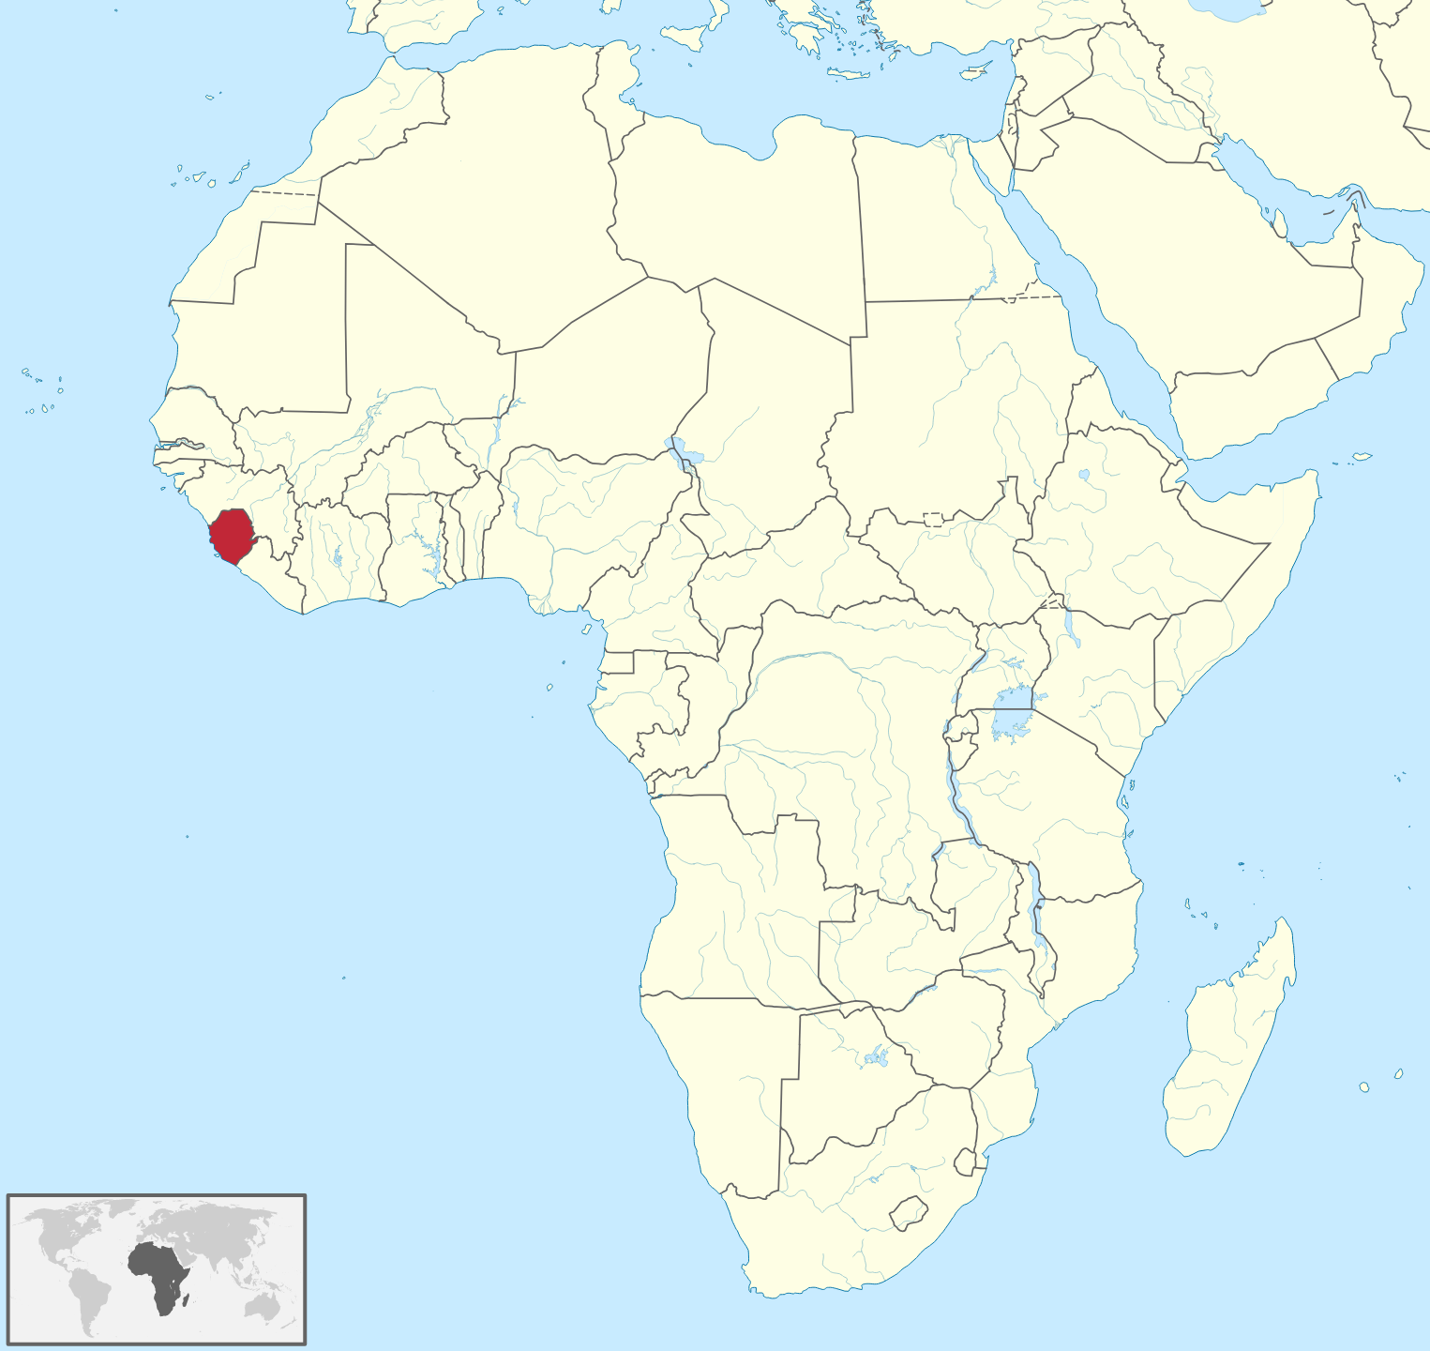
Location
Sierra Leone is a country in West Africa situated on the Atlantic Ocean coast, bordered by Guinea to the north/northeast and Liberia to the southeast. It features a 300-mile coastline, a coastal belt, and a mountainous interior plateau, with its capital, Freetown, located on the peninsula.

Slide 11
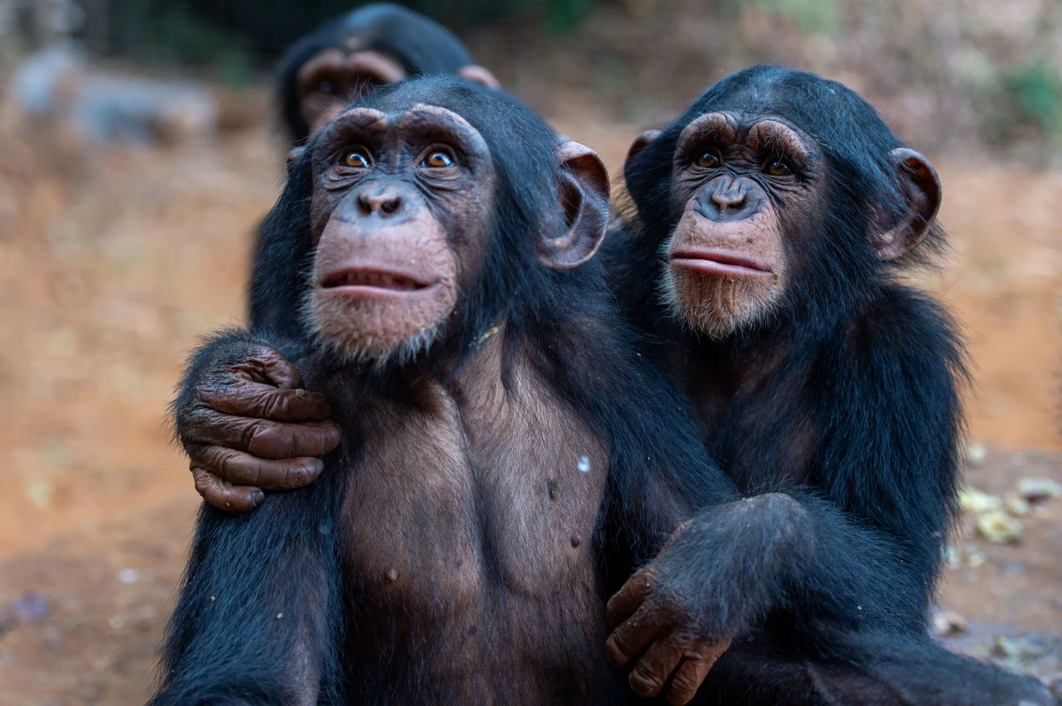
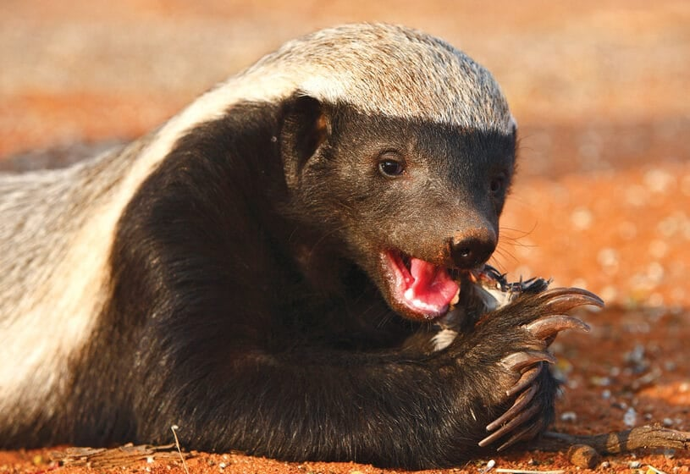
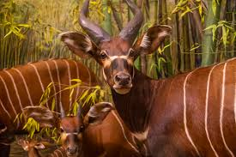
Animals
Sierra Leone is renowned for its rich biodiversity, featuring the Western Chimpanzee (the national animal) as its most famous resident, largely supported by the Tacugama Chimpanzee Sanctuary. Other iconic species include the rare Pygmy Hippopotamus, diverse monkey species, and the elusive White-necked Rockfowl.

Slide 12
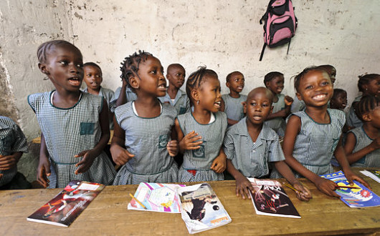
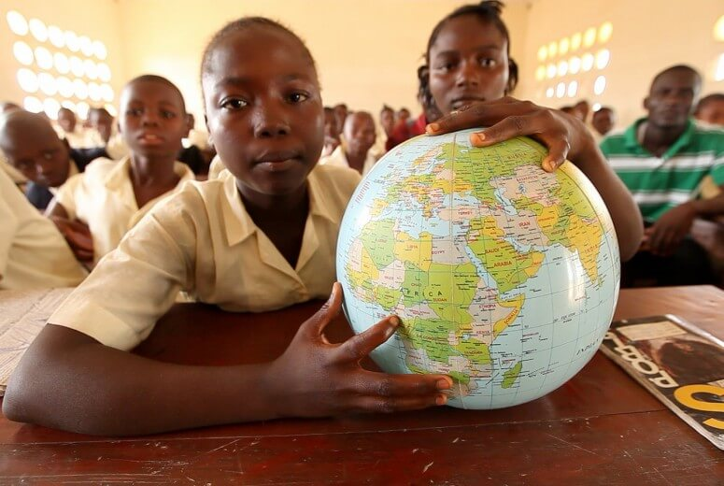
Education
Education in Sierra Leone is undergoing a major transformation through the Free Quality School Education (FQSE) program launched in 2018, which abolished school fees and boosted primary enrollment to near 100%. While primary access is high, challenges remain in secondary school transition (46-67% completion) and, in rural areas, poor infrastructure, crowded classrooms, and teacher shortages.

Slide 13
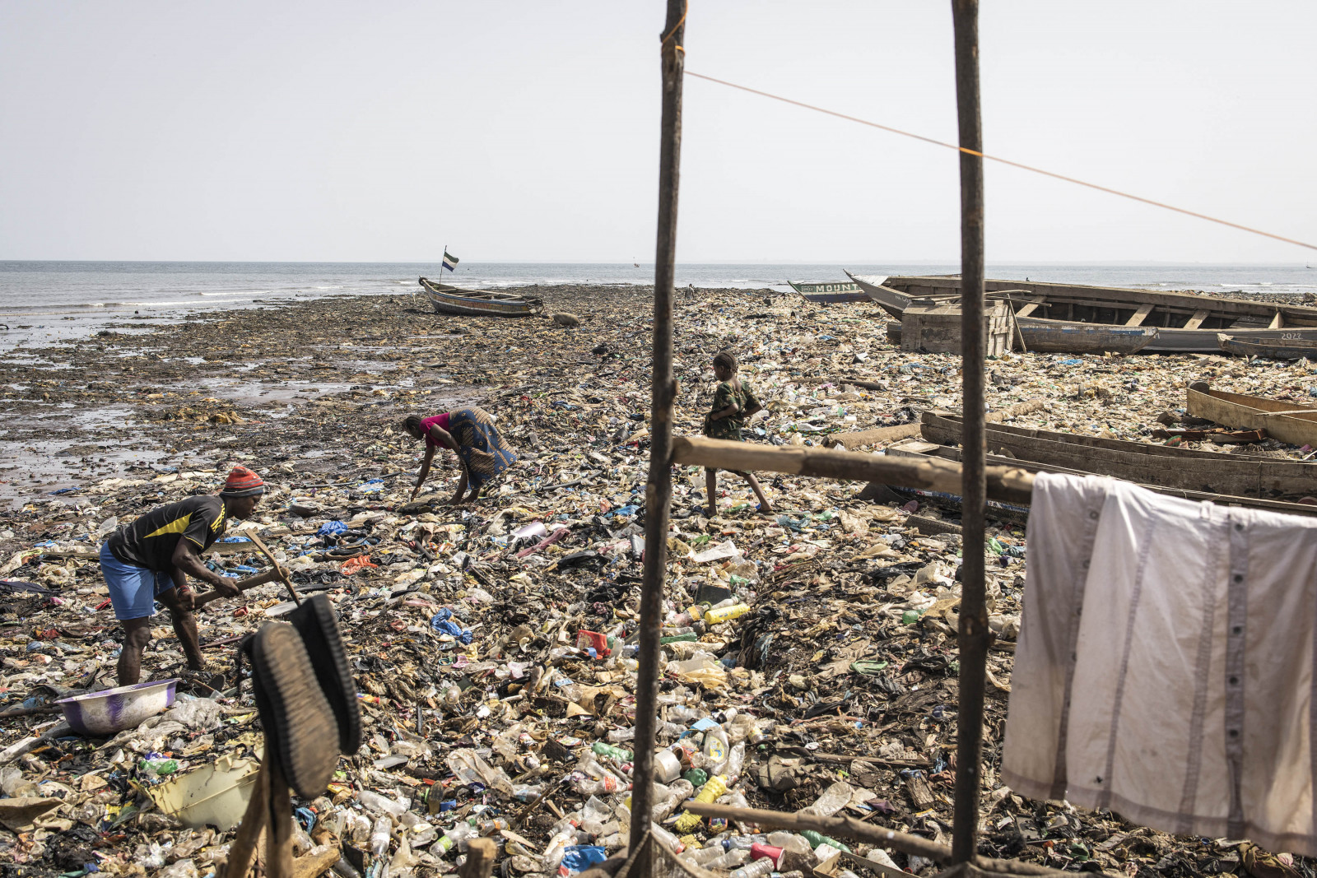
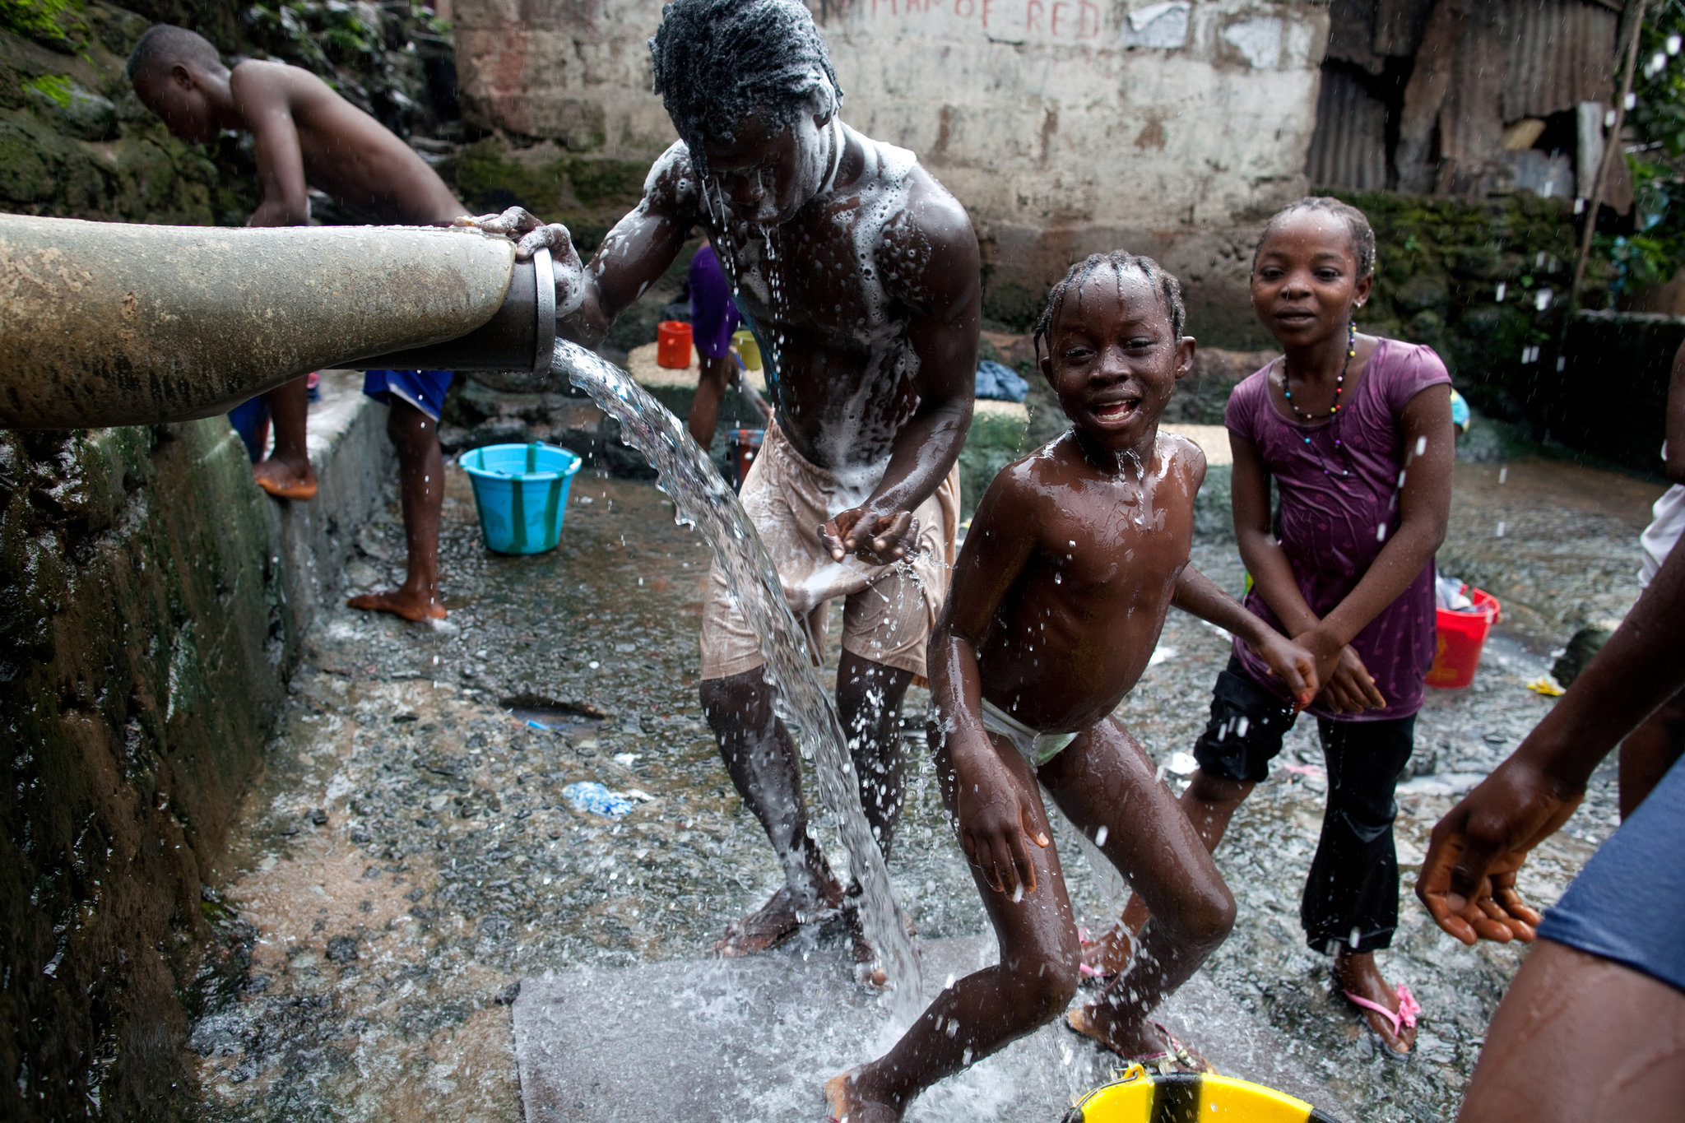
Struggles
Sierra Leone faces significant, ongoing struggles, including extreme poverty, with over 57% of the population living below the poverty line. The nation battles high inflation (approx. 47%), severe food insecurity affecting over 80% of people, and limited infrastructure. Other major challenges include high youth unemployment, a weak healthcare system with low life expectancy, and vulnerability to climate change

Slide 14






Thanks for watching & listening!

